Slide 1
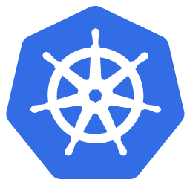
KUBERNETES
📆 01/12/2025
Formateur : Mohamed Ali BETTAIEB

Slide 2
Brise Glace

Slide 3
Comment ça marche ?
1. Choisissez une lettre pour chaque carte
2. Écrivez votre réponse dans le chat Exp: (Carte1: A, Carte2:A, Carte3:A)
3. On regarde les tendances
4. Recueillons rapidement vos attentes et objectifs pour cette formation.

Slide 4
Carte 1 : Votre relation avec Kubernetes
A.
Kubernetes, c'est mon meilleur ami : je l'utilise en prod sans paniquer.
B.
On se fréquente : j'ai déjà déployé quelques services dessus.
C.
On se parle à peine : j'ai juste suivi un tuto ou vu des slides.
D.
On ne s'est jamais rencontrés : je découvre aujourd'hui.

Slide 5
Carte 2 : Votre niveau en Docker
A.
Je construis, tag et pousse mes images les yeux fermés.
B.
Je sais lancer des containers, mais j'hésite encore sur les bonnes pratiques.
C.
J'ai déjà tapé docker run une ou deux fois.
D.
Docker ? Je confonds encore avec une baleine.

Slide 6
Carte 3 : Vos projets avec Kubernetes
A.
J'ai déjà un projet perso ou pro sur Kubernetes (cluster, app, TP…).
B.
Je n'ai pas encore de projet, mais j'ai une idée que j'aimerais lancer.
C.
Pas de projet ni d'idée, je suis surtout là pour comprendre de quoi il s'agit.

Slide 7
Faites vos jeux

Slide 8
LOGISTICS
Schedule Lunch

Slide 9
TABLE OF CONTENTS (1/2)
Context
Architecture and components First steps
Pods
Controllers
Deployment strategies

Slide 10
TABLE OF CONTENTS (2/2)
Service and network exposition
Volumes
Configuration and secrets
Service Account & RBAC
Limits & Autoscaling Extensibility
Summary

Slide 11


Slide 12
CONTEXT
1

Slide 13
AGENDA
Container reminders
Containers without orchestration
Orchestrator features Kubernetes
Kubernetes distributions

Slide 14
CONTAINER REMINDERS
Whether you are Ops or Dev...
No matter how many components you develop/deploy... One of the problems you will have to face...
... is the reproducibility of environments

Slide 15
WHY IS IT SO COMPLICATED?
Diversity of applications to manage Number of applications to manage
Diversity of environments (prod, pre-production, staging, QA, integration...) Environment update constraints

Slide 16
OPS CONSTRAINTS
Multiple applications on the same host Multiple versions of application/server runtime Multiple versions of shared libraries
Multiple versions of operating systems

Slide 17
DEV CONSTRAINTS
Be able to quickly use/test an application / server runtime
Be able to use the dependencies of components developed locally Be able to reproduce production environments (and all the others!)
The current trend is to multiply the number of components, aka micro-services

Slide 18
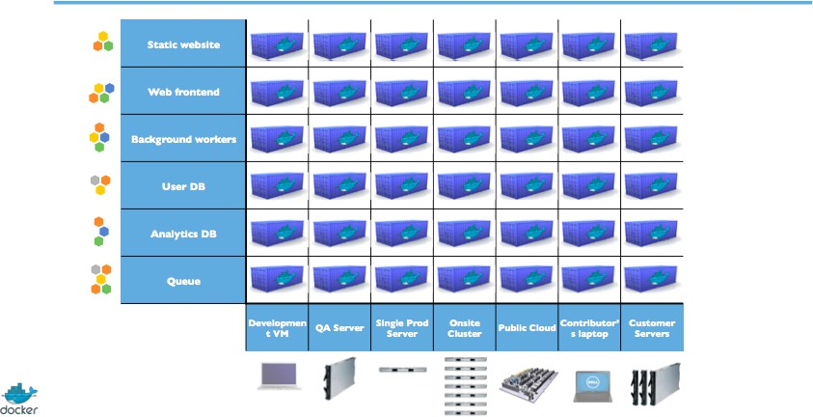
THE CONTAINER / DOCKER WAY

Slide 19
HOW DO CONTAINERS WORK?
Using the host OS kernel to have multiple isolated subsystems:
Process Memory Networks Storage
Peripheral devices
ℹ Each subsystem is called a container

Slide 20
REMINDER: IMAGES (VS. CONTAINERS)
An image:
Read-only model used to start containers, immutable
Contain all the file needed by the application: middleware + application but environment agnostic
Built by you or others automatically (e.g. Dockerfile) with different tools: docker, kaniko, jib...
Stored on your host, the Docker Hub or your private registry Specification: image-sp ec from the Open Container Initiave

Slide 21
REMINDER: (IMAGES VS) CONTAINERS
A container:
Is created from an image
Contains everything your app needs to run Has a lifecycle (create/start/stop/restart) Lifetime:
milliseconds: commands minutes/hours: batch
minutes/days: version of an application
Many runtimes: containerd from Docker, CRI-O
Specification: runtime-spec

Slide 22
CONTAINERS
A container runs natively on Linux and shares the kernel of the host machine with other containers
A container runs natively only for Windows programs on Windows 10 and newer
A container runs a process like the others, which does not take up more memory or more CPU than any other executable
A container is therefore light (or rather as light as the process it runs)
In contrast, a virtual machine (VM) runs a complete operating system with virtual access to the host machine's resources, through a hypervisor
Most of the time, a VM provides an environment with more available resources than the applications really need

Slide 23
WHERE TO USE CONTAINERS?
On the developer's workstation On the tester's workstation
On integration / QA environments In production
⭐ Ideally: EVERYWHERE (Continuous Delivery)

Slide 24





Slide 25
CONTAINERS WITHOUT ORCHESTRATION
How to start containers?
using the docker CLI? using docker-compose? using shell script?
using [insert here your favorite configuration management tool] (Ansible, SaltStack, Chef, Puppet, ...)

Slide 26
PET VS CATTLE
How to choose on which hosts should run your containers❓
🐈 : In Pet mode (micro management), we identify a server with a name, we know its characteristics and what it contains, we keep it up to date, we patch it and humans (usually ops) choose where to spin a container
🐄 : In Cattle mode (macro management), we use the characteristics (via tags/labels) of the servers to identify a subset of them, we do not try to patch or manually keep them up to date, we replace as needed to maintain a number of machines and we use automation to place our container on a machine via constraints

Slide 27
WHY USE AN ORCHESTRATOR
Orchestrators are tools built to ease the management of containerized workloads often called "Datacenter Operating Systems"
Take care of the deployment of your application and its network accessibility

Slide 28
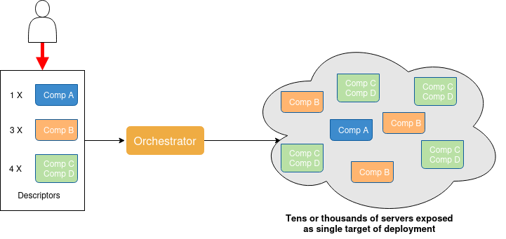
THE ORCHESTRATOR FROM A FINAL USER PERSPECTIVE

Slide 29
PLACEMENT AND CONTAINER LIFECYCLES
The orchestrator will choose where to host your containers according to constraints:
technical constraints: network, hardware (GPU, HDD/SSD) co-localisation (affinity, anti-affinity, ...)
number of replicas/copies CPU/memory/storage resources availability

Slide 30
FAILOVER MANAGEMENT
The orchestrator will restart components that failed: containers
nodes/hosts
The orchestrator offers native high availability for control plane components

Slide 31
NETWORKING FEATURES
Load Balancing Service Discovery
Networks shared by all containers across nodes (most of the time overlays) so that containers don't need to be connected using node ports anymore

Slide 32
ORCHESTRATION FEATURES
Distributed storage management Configuration and Secrets Manual and auto scaling
Interaction through a command line and a REST API
Text descriptors that can be managed like the rest of the application code
Role Based Access Control: management of who can do what

Slide 33
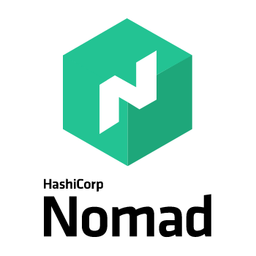

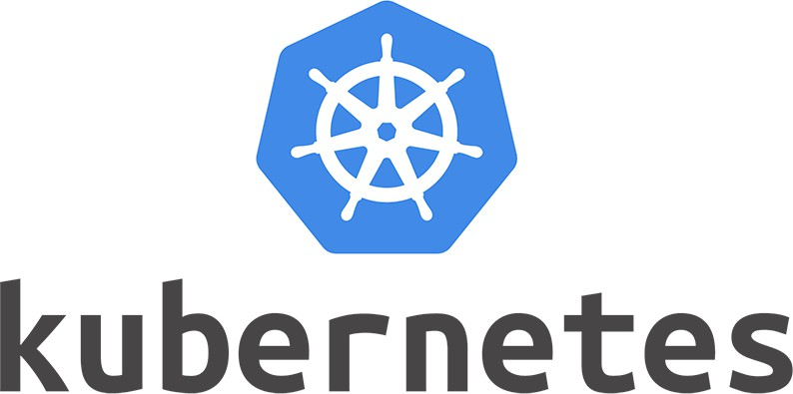
ORCHESTRATORS

Slide 34
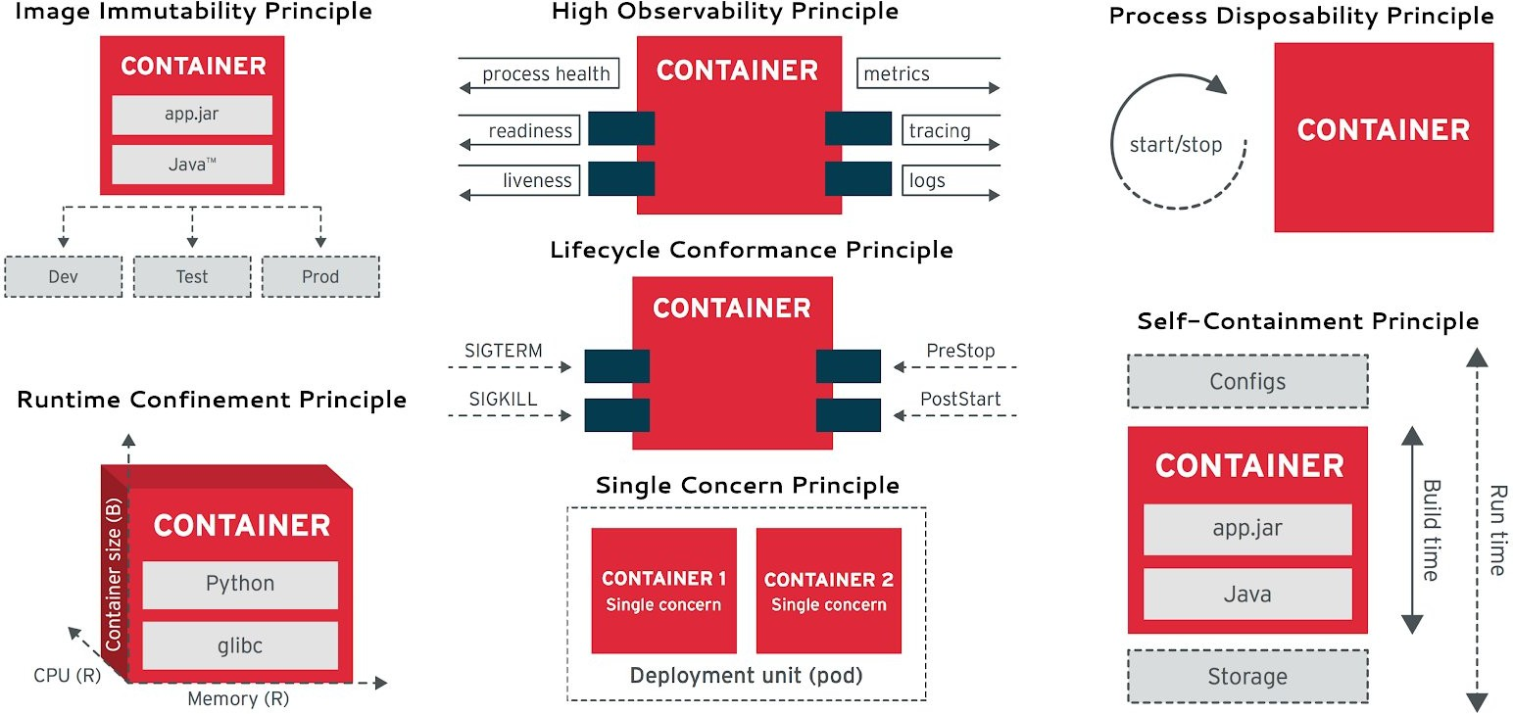
ORCHESTRATOR READY APPLICATIONS
https://medium.com/@bibryam/cloud-native-container-design-principles-144ceaa98dba
Notes:
Voyons ensemble chaque principe :
1️⃣ Image Immutability Principle (Principe d'Immuabilité de l'Image)
Votre conteneur doit être basé sur une image immuable (read-only). Ça veut dire qu'une fois l'image construite, elle ne change jamais. Si vous avez besoin de modifier quelque chose, vous reconstruisez une nouvelle image. C'est crucial car cela garantit que chaque instance du conteneur se comporte exactement pareil, peu importe où et quand elle tourne. C'est votre point de reproductibilité.
2️⃣ High Observability Principle (Principe de Haute Observabilité)
Un conteneur orchestrator-ready doit exposer les signaux de santé de votre application :
Process health : est-ce que mon processus principal tourne ?
Readiness : est-ce que mon app est prête à recevoir du trafic ?
Liveness : est-ce que mon app est toujours vivante ou elle est bloquée ?
Metrics (métriques) : combien de requêtes, latence, etc.
Tracing : où s'exécute le code en ce moment ?
Logs : que fait mon app, est-ce qu'il y a des erreurs ?
Sans ces signaux, l'orchestrator ne peut pas prendre les bonnes décisions. Il faut les implémenter dans votre app.
3️⃣ Process Disposability Principle (Principe de Jetabilité du Processus)
Votre conteneur doit accepter d'être tué n'importe quand : on le lance, il tourne, on l'arrête (start/stop). Pas d'état long terme à l'intérieur du conteneur. C'est le modèle "cattle, not pets" : au lieu d'essayer de soigner un conteneur qui a un problème, on le tue et on en relance un nouveau. C'est beaucoup plus rapide et robuste.
4️⃣ Lifecycle Conformance Principle (Principe de Conformité du Cycle de Vie)
Votre conteneur doit répondre aux signaux d'arrêt gracieux :
SIGTERM : reçoit ce signal, il a du temps pour terminer ses traitements, fermer les connexions BD, etc.
SIGKILL : s'il n'a pas stoppé assez vite après SIGTERM, on le force à arrêter (last resort).
PreStop / PostStart : des hooks optionnels pour exécuter du code avant/après le démarrage.
Ça garantit que les données ne sont pas corrompues lors des arrêts.
5️⃣ Runtime Confinement Principle (Principe de Confinement du Runtime)
Votre conteneur doit avoir des limites de ressources clairement définies :
CPU (R) : il faut que l'orchestrator sache combien de CPU vous allouez.
Memory (R) : combien de RAM a besoin votre app pour fonctionner ?
CPU(libc) : l'orchestrator peut confiner les processus et répartir équitablement les ressources.
Sans ces limites, un conteneur qui fuit mémoire va bouffer toutes les ressources du cluster et pourrir tout le monde.
6️⃣ Single Concern Principle (Principe de Responsabilité Unique)
Un Pod (unité de déploiement Kubernetes) = un conteneur = une responsabilité. Ne mettez pas 5 services différents dans le même conteneur. Si votre app fait plusieurs choses, utilisez plusieurs conteneurs/Pods. Ça permet à l'orchestrator de scaler chaque composant indépendamment et de les redéployer sans impacter les autres.
7️⃣ Self-Containment Principle (Principe d'Auto-Confinement)
Votre conteneur doit être autonome :
Configs : Les paramètres de configuration viennent de l'extérieur (variables d'env, ConfigMaps, Secrets).
Build time vs Runtime : Vous définissez ce qui est fixe à la construction, et ce qui est flexible à l'exécution.
Storage : Si vous avez besoin de persistance, vous déclarez ça, l'orchestrator vous fournira des volumes.
Grâce à ça, la même image peut tourner en dev, en test, en prod avec juste des configs différentes.
Conclusion
En résumé, une application orchestrator-ready c'est une app qui : ✅ Expose sa santé ✅ Accepte d'être stoppée/relancée ✅ Gère ses ressources ✅ Est modulaire ✅ Se configure à l'exécution

Slide 35
KUBERNETES

Slide 36
KUBERNETES DEFINITION
Kubernetes is an open source platform designed to automate, scale and operate containerized workload

Slide 37
HISTORY
Google initiated the Kubernetes project in 2014
Kubernetes is based on 15 years of experience during which Google has been running large- scale applications in production:
Borg Omega
Kubernetes v1.0 was released in 2015 and at the same time the Cloud Native Computing Foundation (CNCF) was created to host the project
Kubernetes has been enriched over time by the ideas and practices brought by a very active community

Slide 38
NAME ORIGIN
The name Kubernetes comes from the Greek, and means Headmaster or Pilot
k8s is an abbreviation derived from replacing the 8 letters of “ubernete” with an “8”
Pronunciation koo-ber-nay'-tisse

Slide 39
DISTRIBUTIONS
Installation of Kubernetes with different choices and features: Operation on dev station (single node)
Automatic high availability of control nodes, Control Plane
WEB management console Federation of clusters Automated installation
Integration of a continuous integration factory
...

Slide 40


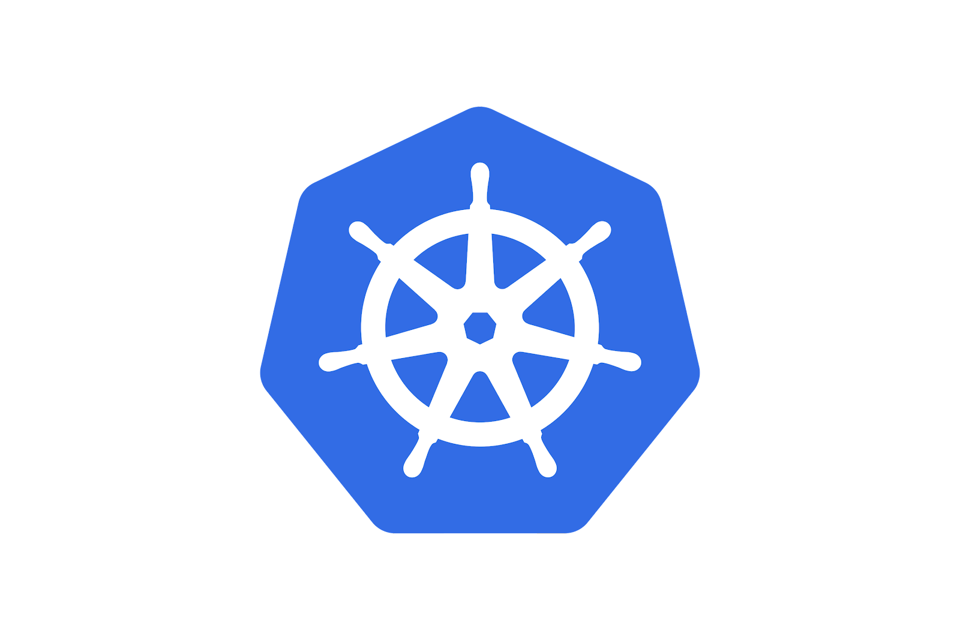

ON PREMISES
Kubernetes
Mirantis Kubernetes Engine

Slide 41
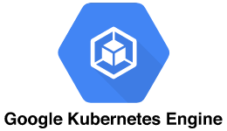


MANAGED / CLOUD
Azure Kubernetes Service
Scaleway Kapsule
OVH Managed Kubernetes Digital Ocean
RedHat Openshift Online IBM Kubernetes

Slide 42
OTHER DISTRIBUTIONS
PKS /Pivotal Container Service
kubeadm (documentation), minikube and kind Docker Desktop
kops (Kubernetes Operations)
Ansible Playbooks (kubesp ray and kubernetes/contrib) and modules Ansible K3S and k3d by Rancher
MicroK8s by Canonical RKE2 by Rancher
List: Kubernetes Distributions and Platforms maintained by the Linux Foundation

Slide 43
KUBERNETES VERSIONS
v1.30.0 the 2024-04-17
v1.29.0 the 2023-12-13
v1.28.0 the 2023-08-15
...
v1.0.0 the 2015-07-13
All Changelogs All Releases
ℹ This training is written against version v1.30.

Slide 45
ARCHITECTURE AND COMPONENTS
2

Slide 46
AGENDA
Architecture Control Plane Workers

Slide 47
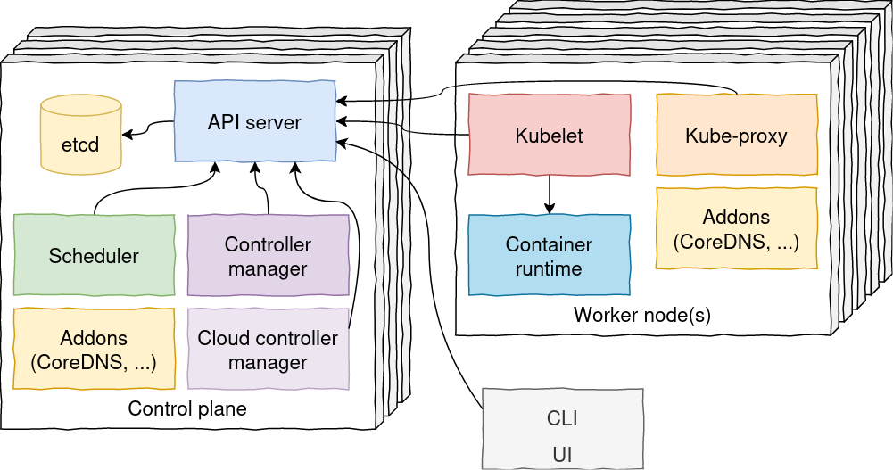
ARCHITECTURE

Slide 48
CONTROL PLANE
In charge of managing the resources of the cluster according to user requests Makes global cluster decisions: where to start a Pod for example
Reacts to internal events like the loss of a Node
Must be installed in high availability: several VMs or physical machines ideally in odd numbers spread across several geographical sites

Slide 49
HIGH AVAILABILITY
Number of control-plane nodes defines your fault tolerance
2*n + 1 control-plane nodes are needed to handle n failures If the control plane fails:
No updates/modifications can be applied to existing workloads and configurations Workloads are not moved when a worker node fails
But:
Workloads stays online
Containers can be restarted by the kubelet on the same node if required because it is not managed by a controller

Slide 50
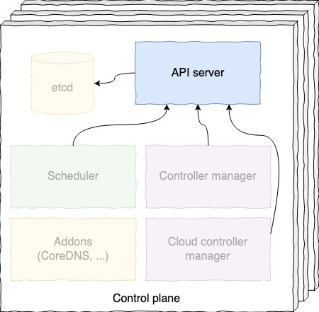
API SERVER
The API Server is the entry point to the Kubernetes cluster.
All queries and alteration requests will go through it. It manages:
authentication authorization
syntax and semantic requests validation

Slide 51
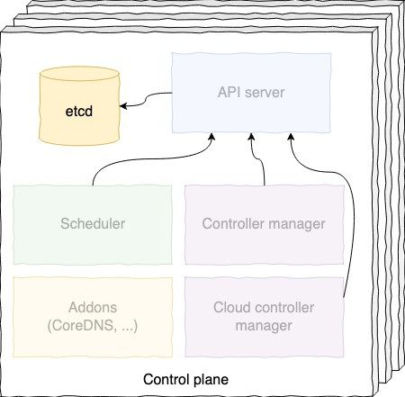
ETCD
etcd is the Kubernetes database.
It stores:
the descriptors of the applications that you deploy the current state of what is running on the cluster
etcd is never accessed directly, but always through the API Server

Slide 52
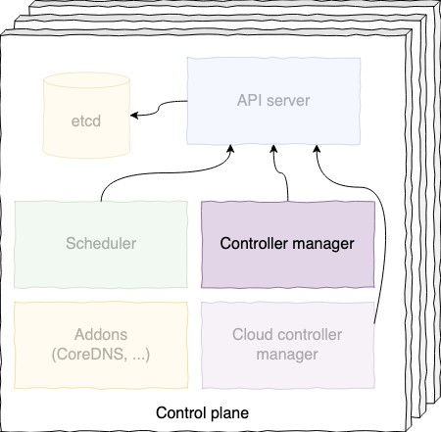
CONTROLLER MANAGER
Implements control loop for workloads (ReplicaSet,
Deployment, ...) and other resources
Works in active / passive mode
Current active controller is reported in etcd

Slide 53
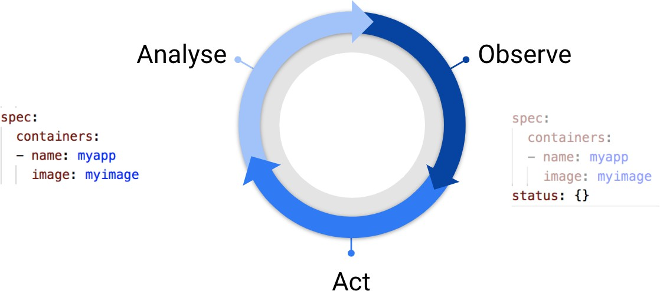
CONTROLLER MANAGER

Slide 54
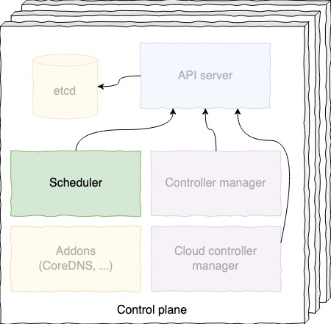
SCHEDULER
Choose which node should run a container The algorithm is based on several criteria:
available resources
constraints affinities, etc.
Also works in active / passive mode

Slide 55
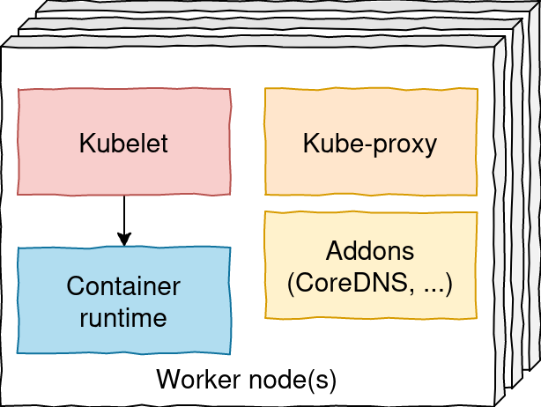
WORKERS
Components installed on shared nodes providing the CPU, memory, GPU used by Pods
VMs where applications actually run

Slide 56
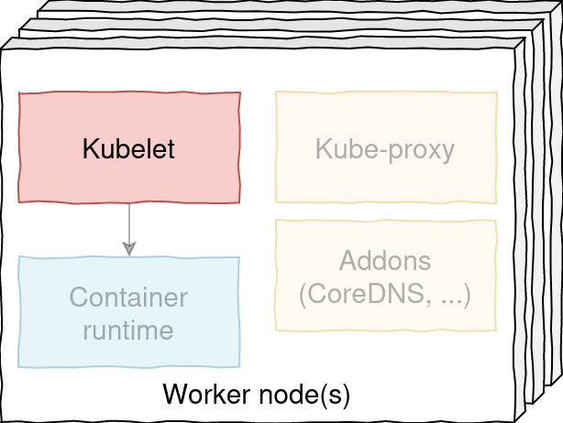
KUBELET
In charge of starting/stopping containers with the container runtime
Supervises containers
Notifies the API Server of container lifecycle events

Slide 57
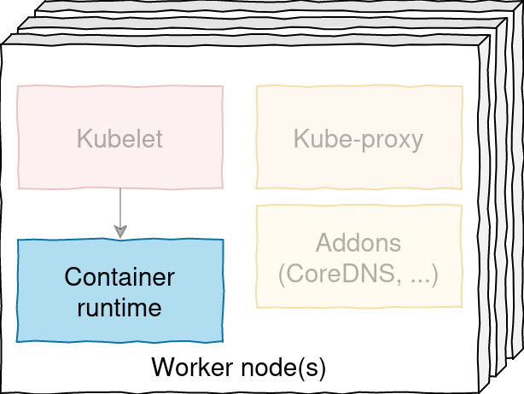
CONTAINER RUNTIME
The kubelet manages container runtimes that implement the Container Runtime Interface (CRI)
containerd, from Docker, CNCF project
CRI-O
Docker, not natively supported since K8S 1.24
it does not implement CRI and therefore requires an additional component: the adapter cri-dockerd
It is possible to use multiple container runtimes at the same time.

Slide 58
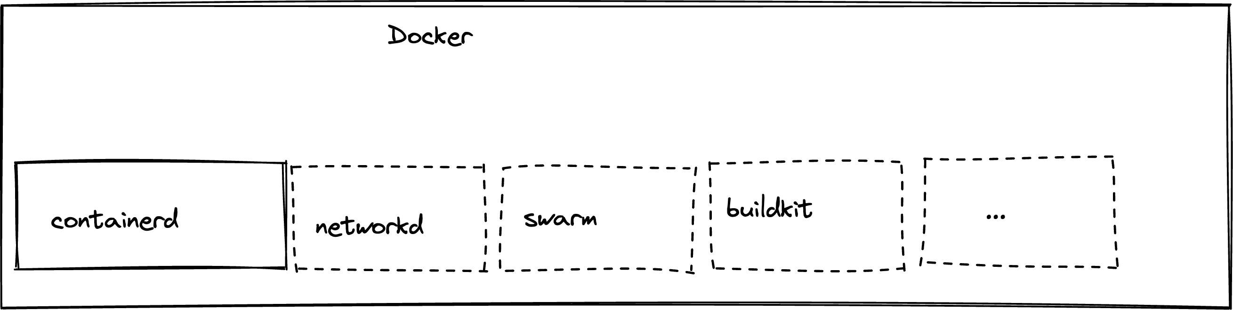
KUBERNETES WITHOUT DOCKER
Since version 1.24 of Kubernetes released in April 2022, Kubernetes no longer supports Docker natively.
➡ Don't panic
The container runtime you use is transparent on the developer side, you continue to use Docker images (OCI format)
However Docker on a Developer workstation is still relevant!

Slide 59
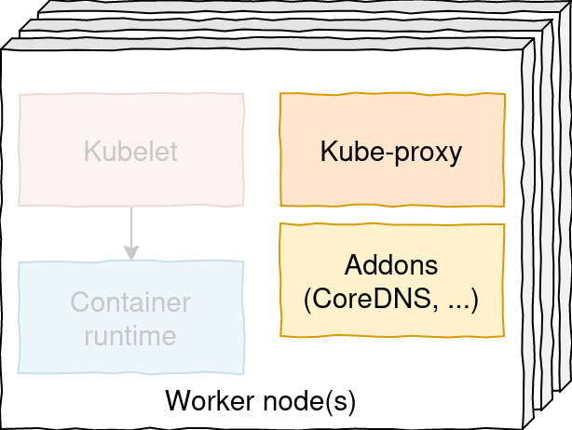
KUBE-PROXY & ADDONS
kube-proxy: maintains network rules on nodes for network routing for Services and NodePort (iptables or IPVS)
addons : embedded DNS server, CNI + CSI driver CNI: Container Network Interface (eg: Calico)
CSI: Container Storage Interface (eg: EBS/EFS volumes on AWS)

Slide 61
FIRST STEPS WITH KUBERNETES
3

Slide 62
AGENDA
Local installation with minikube CLI
Start a container

Slide 63

MINIKUBE

Slide 64
A LOCAL KUBERNETES INSTANCE
minikube is a tool that allows you to easily launch a local Kubernetes instance
... but consisting of only a single node by default (possibility to get more nodes using -n or -
-nodes option)
... in a VM on your workstation for example
which allows you to use Kubernetes from the Developer's Workstation environment (or the
tester...or the operator!)
minikube start --kubernetes-version v1.30.0
😄 minikube v1.32.0 on Ubuntu 20.04
...
Verifying Kubernetes components...
Using image gcr.io/k8s-minikube/storage-provisioner:v5
🌟 Enabled addons: default-storageclass, storage-provisioner
🏄 Done! kubectl is now configured to use "minikube" cluster and "default" namespace by default

Slide 65
CONTINUOUS INTEGRATION AND MINIKUBE
By default, the --driver=docker option is used, which will deploy the entire minikube in a container and expose the Kubernetes API on the IP of this container
This allows to create multiple clusters on the same machine
So it is possible to use minikube in continuous integration steps to create an ephemeral cluster for testing!

Slide 66
MINIKUBE ADDONS
minikube comes with a set of addons which can be enabled, disabled and used The command minikube addons list lists the known addons and their state
The command minikube addons enable ${ADDON_NAME} activates an addon (minikube must be running)
minikube addons enable metrics-server
Using image registry.k8s.io/metrics-server/metrics-server:v0.6.2
🌟 The 'metrics-server' addon is enabled

Slide 67
DEFAULT ADDONS
minikube addons list
|-----------------------------|----------|------------|--------------------------|
| ADDON NAME | PROFILE | STATUS | MAINTAINER |
|-----------------------------|----------|------------|--------------------------|
| | ambassador | | | minikube | | | disabled | | | 3rd party (Ambassador) | |
| | auto-pause | | | minikube | | | disabled | | | Google | |
| | dashboard | | | minikube | | | disabled | | | Kubernetes | |
| | default-storageclass | | | minikube | | | enabled ✅ | | | Kubernetes | |
| | efk | | | minikube | | | disabled | | | 3rd party (Elastic) | |
| | gvisor | | | minikube | | | disabled | | | Google | |
| | ingress | | | minikube | | | disabled | | | Kubernetes | |
| | istio | | | minikube | | | disabled | | | 3rd party (Istio) | |
| | kong | | | minikube | | | disabled | | | 3rd party (Kong HQ) | |
| | metallb | | | minikube | | | disabled | | | 3rd party (MetalLB) | |
| | metrics-server | | | minikube | | | disabled | | | Kubernetes | |
| | portainer | | | minikube | | | disabled | | | 3rd party (Portainer.io) | |
| | registry | | | minikube | | | disabled | | | Google | |
| | storage-provisioner | | | minikube | | | enabled ✅ | | | Google | |
| | storage-provisioner-gluster | | | minikube | | | disabled | | | 3rd party (Gluster) | |
| | volumesnapshots | | | minikube | | | disabled | | | Kubernetes | |
(...)

Slide 69
CLI ( )
Use kubectl to interact on the command line with your Kubernetes instances Online documentation is available on https://kubernetes.io/docs/reference/kubectl/

Slide 70
KUBECTL: LIST AVAILABLE COMMANDS
kubectl
kubectl controls the Kubernetes cluster manager.
Find more information at: https://kubernetes.io/docs/reference/kubectl/overview/
Basic Commands (Beginner):
create Create a resource from a file or from stdin.
expose Take a replication controller, service, deployment or pod and expose it as a new Kubernetes Service
run set
Run a particular image on the cluster Set specific features on objects
Basic Commands (Intermediate):
explain get
edit
delete
label selector (...)
Documentation of resources Display one or many resources Edit a resource on the server
Delete resources by filenames, stdin, resources and names, or by resources and

Slide 71
KUBECTL: COMMAND LINE INTERFACE HELP
Run kubectl to see the list of all available commands
Run kubectl <command> --help to see help for a particular command
Run kubectl options to see the list of global options (which apply to all commands)

Slide 72


Slide 73
START A FIRST CONTAINER IN K8S
The best way to deploy an application in Kubernetes ensuring reproducibility uses a descriptor file in YAML (or JSON) format
It is also possible to use the run command to do it without a descriptor

Slide 74
'KUBECTL RUN' USAGE
The command:
kubectl run whoami --image=traefik/whoami:v1.10 --port=80
starts a Pod (which we will see in detail in the chapter Pods) from image traefik/whoami:v1.10
and references the 80 port of the created container
"references" allow the use of this port later
Not specifying a port does not prevent the port from being accessible

Slide 75
'KUBECTL RUN' EXAMPLES
Start a single instance from the nginx image
kubectl run nginx --image=nginx:1.25
Start a hazelcast instance and specifies environment variables
kubectl run hazelcast --image=hazelcast:5 --env="DNS_DOMAIN=cluster"

Slide 76
'KUBECTL GET CONTAINERS'?
There is no kubectl command to list the launched containers The smallest unit is the Pod
We can therefore launch kubectl get pods (or kubectl get po using the Pods resource shortcut)

Slide 77
LIST PODS
kubectl get pods
NAME | READY | STATUS | RESTARTS | AGE
whoami | 1/1 | Running | 0 | 2m
Note, by default, the following informations are reported:
The name of the Pod
The number of ready containers (a Pod can contain several containers) Pod status (Running, Terminating, CrashLoopBackOff, Pending, ...)
The number of restarts of the Pod's containers
The age of the Pod: how long has the request to create the Pod been taken into account

Slide 78
EXTENDED INFORMATIONS ON PODS
The --output (or -o) flag can be used to modify the output format
wide or name
kubectl get pods --output wide NAME READY STATUS RESTARTS |  | AGE | IP | NODE | NOMINATED | NODE | READINESS GATES
whoami | 1/1 Running 0 | 13s | 172.17.0.4 | minikube | <none> |  | <none>
kubectl get pods -o name pods/whoami

Slide 79
CUSTOM COLUMNS
-o flag can be used to modify the output format :
custom-columns=... or custom-columns-file=... (Documentation) go-template=... or go-template-file=... (Documentation) jsonpath=... or jsonpath-file=... (Documentation)
kubectl get pods -o=custom-columns=NAME:.metadata.name,IP:.status.podIP NAME IP
whoami 10.244.120.68

Slide 80
VIEW ALL POD'S DETAILS
kubectl describe pod <pod-name> shows detailed info on a Pod
kubectl describe pod whoami
Name:
whoami default
minikube/172.31.34.5
Sun, 08 Oct 2023 19:02:51 +0200
run=whoami Running 10.244.120.68
Namespace: Node:
Start Time:
Labels: Status: IP:
...
Events: Type
Reason
Age
From
Message
Normal minikube
Scheduled
4m58s
default-scheduler
Successfully assigned default/whoami to
Normal Normal | Pulling Pulled | 4m55s 4m53s | kubelet kubelet | Pulling image "traefik/whoami:v1.10" Successfully pulled image
traefik/whoami:v1.10" in 2.413404591s (2.413411021s including waiting) Normal Created 4m53s kubelet Created container whoami
Normal | Started | 4m53s kubelet |  | Started container whoami
"

Slide 81
VIEW EVEN MORE INFORMATION ON PODS
The --output (ou -o) flag can be used to display all the informations
kubectl get pod <pod-name> -o yaml apiVersion: v1
kind: Pod
metadata:
creationTimestamp: "2024-10-09T10:19:00Z" labels:
run: whoami
name: whoami namespace: default
resourceVersion: "3297"
uid: 2b932d6a-3957-44e9-ae37-3ef1ea265459
...

Slide 82
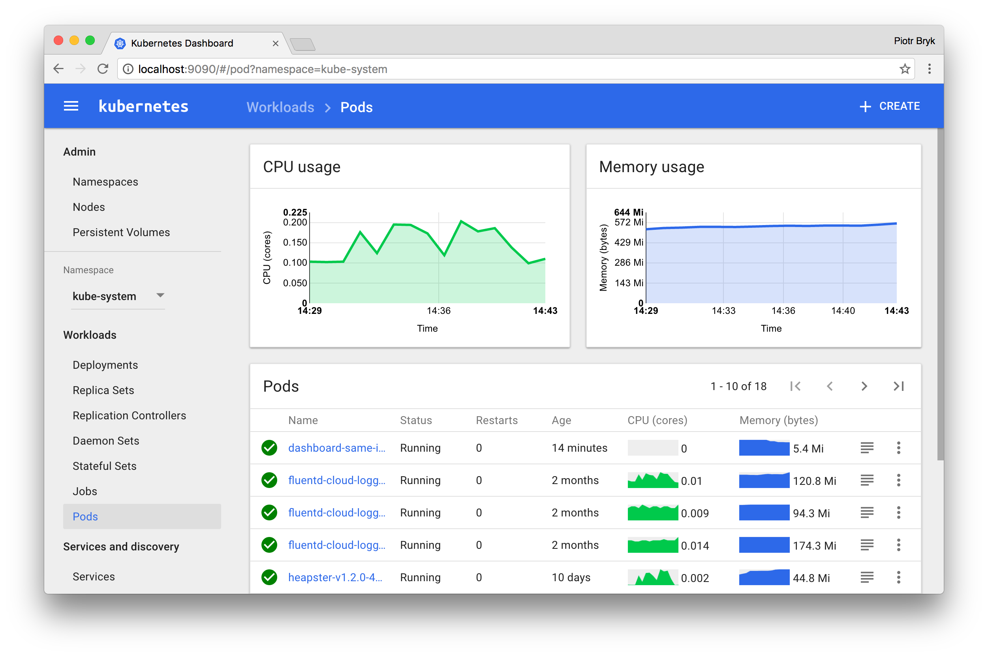
DASHBOARD

Slide 83
KUBERNETES' DASHBOARD
The Dashboard is a web interface allowing to interact with a Kubernetes instance The Dashboard allows you to:
deploy apps
search for information regarding the abnormal behaviour of a deployed application view all deployed applications
modify the configuration of deployed applications and update them
The Dashboard also makes it possible to know the state of the resources of an instance and to access the logs of the components of the cluster as well as those of the applications
In order to display metrics and graphs on the Dashboard, the metrics-server must be installed in the cluster

Slide 86
PODS
4
2024-12-15#547bc88

Slide 87
AGENDA
Pod concept Pod descriptors
Pods organisation with labels, selectors and Namespaces SecurityContext
InitContainers
Pods lifecycle and HealthChecks Resource handling

Slide 88
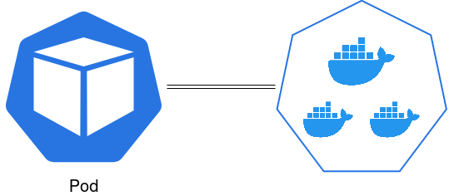
POD CONCEPT
A Pod is a group of one or more containers
The Pod is the fundamental basis of a k8s deployment
It is the smallest deployment unit that we can create / deploy
The concept of the Pod allows containers to share resources so that they can collaborate more easily.

Slide 89
NAMESPACE SHARING BETWEEN POD CONTAINERS
Containers within a Pod share the same IPC and therefore can communicate using SystemV
semaphores or POSIX shared memory
Containers within a Pod share the same IP address, port space and can 'find' each other through localhost
Containers within a Pod can access the same Volumes Pod containers are always co-located and co-managed

Slide 90
HOW TO CHOOSE BETWEEN MULTI OR SINGLE CONTAINER POD?
Ask yourself the questions:
Do the containers have to run in the same place or can they be spread over several nodes? Do the containers represent a single whole or are they independent components?
Can/should containers be scaled together individually?
Most of the time you should separate your containers into separate Pods unless there is a specific reason not to!

Slide 91
USE CASE OF MULTIPLE CONTAINERS IN A POD
Reload hot configuration on event trigger
Web container (Nginx, Apache, ...) + php-fpm container Service routing
Log aggregation Telemetry
The big advantage is not having to modify the main application
In this context of use, the containers associated with the main container are sometimes called
sidecar containers or sidekick containers

Slide 92
YAML DESCRIPTOR
Instead of using kubectl run xxx ...
You should use YAML (or JSON) descriptors

Slide 93
YAML DESCRIPTOR EXAMPLE
---
apiVersion: v1 kind: Pod metadata:
name: whoami
labels:
stack: market spec:
containers:
name: whoami
image: traefik/whoami:v1.10 imagePullPolicy: Always ports:
containerPort: 80
containerPort: 443 restartPolicy: Always

Slide 94
SAME DESCRIPTOR AS JSON
{
"apiVersion": "v1",
"kind": "Pod", "metadata": {
"name": "whoami",
"labels": { "stack": "market" }
},
"spec": {
"containers": [
{
"name": "whoami",
"image": "traefik/whoami:v1.10", "imagePullPolicy": "Always", "ports": [
{ "containerPort": 80 },
{ "containerPort": 443 }
],
}
],
"restartPolicy": "Always"
}
}

Slide 95
GENERATE A DESCRIPTOR WITHOUT CREATING RESOURCES
Display descriptors without actually creating objects
kubectl run whoami --image=traefik/whoami:v1.10 --port=80 --dry-run=client -o yaml
apiVersion: v1 kind: Pod metadata:
creationTimestamp: null
labels:
run: whoami name: whoami
spec:
containers:
- image: traefik/whoami:v1.10 name: whoami
...

Slide 96
DESCRIPTOR FILE CONTENT
The YAML descriptor can be broken down into several sub-parts:
apiVersion kind metadata
spec, data, rules or stringData
These sub-parts are found in all types of resource

Slide 97
AVAILABLE RESOURCES
kubectl api-resources
NAME | SHORTNAMES | APIVERSION | NAMESPACED | KIND
configmaps | cm | v1 | true | ConfigMap
endpoints | ep | v1 | true | Endpoints
limitranges | limits | v1 | true | LimitRange
namespaces | ns | v1 | false | Namespace
nodes | no | v1 | false | Node
persistentvolumeclaims | pvc | v1 | true | PersistentVolumeClaim
persistentvolumes | pv | v1 | false | PersistentVolume
pods | po | v1 | true | Pod
secrets |  | v1 | true | Secret
services | svc | v1 | true | Service
daemonsets | ds | apps/v1 | true | DaemonSet
deployments | deploy | apps/v1 | true | Deployment
replicasets | rs | apps/v1 | true | ReplicaSet
statefulsets | sts | apps/v1 | true | StatefulSet
horizontalpodautoscalers | hpa | autoscaling/v2 | true | HorizontalPodAutoscaler
cronjobs | cj | batch/v1 | true | CronJob
jobs |  | batch/v1 | true | Job
ingresses | ing | networking.k8s.io/v1 | true | Ingress
networkpolicies | netpol | networking.k8s.io/v1 | true | NetworkPolicy
(...)

Slide 98
USE 'KUBECTL EXPLAIN' TO SEE RESOURCES DOCUMENTATION
kubectl explain pods
DESCRIPTION:
Pod is a collection of containers that can run on a host. This resource is created by clients and scheduled onto hosts.
FIELDS:
metadata <Object>
Standard object's metadata. More info: https://git.k8s.io/community/contributors/devel/api-conventions.md#metadata
spec <Object>
Specification of the desired behavior of the Pod. More info: https:// git.k8s.io/community/contributors/devel/api-conventions.md#spec-and-status/
status <Object>
Most recently observed status of the Pod. This data may not be up to date. Populated by the system. Read-only. More info: https://git.k8s.io/community/ contributors/devel/api-conventions.md#spec-and-status/
(...)

Slide 99
USE JSON PATHS TO SEE MORE
kubectl explain pods.spec.containers
RESOURCE: containers <[]Object>
DESCRIPTION:
List of containers belonging to the Pod. Containers cannot currently be added or removed. There must be at least one container in a Pod. Cannot be updated.
A single application container that you want to run within a Pod.
FIELDS:
workingDir <string>
Container's working directory. If not specified, the container runtime's default will be used, which might be configured in the container image. Cannot be updated.
command <[]string>
Entrypoint array. Not executed within a shell. The docker image's
ENTRYPOINT is used if this is not provided. Variable references $(VAR_NAME) (...)

Slide 100
VALUES CONSTRAINTS IN DESCRIPTORS
kubectl explain pods.spec.containers
... FIELDS:
...
imagePullPolicy <string>
Image pull policy. One of Always, Never, IfNotPresent. Defaults to Always if :latest tag is specified, or IfNotPresent otherwise. Cannot be updated. More info:
https://kubernetes.io/docs/concepts/containers/images#updating-images
name <string> -required-
Name of the container specified as a DNS_LABEL. Each container in a Pod must have a unique name (DNS_LABEL). Cannot be updated.
...

Slide 101
DNS_LABEL
The specified as a DNS_LABEL constraint refers to rfc1123
a DNS-1123 label must consist of lower case alphanumeric characters or '-', and must start and end with an alphanumeric character (e.g. my-name, or 123-abc, regex used for validation is [a-z0-9]([-a-z0-9]*[a-z0-9])?)
⚠ Kubernetes requires the use of lower case values (see PR 39675)

Slide 102
IMAGEPULLPOLICY
imagePullPolicy allows to configure k8s policy for fetching images It is set by default to:
Always if the container image tag is latest IfNotPresent if tag not latest
Ex :
image: nginx
imagePullPolicy defaults to Always
image: my-service-springboot:1.2.1-SNAPSHOT
imagePullPolicy defaults to IfNotPresent but what you usually want is Always
image: my-service-springboot:1.2.1
imagePullPolicy = IfNotPresent
➡ It is strongly advised to be explicit and always specify the value of the imagePullPolicy, it should be Always most of the time

Slide 103
CREATE A POD FROM A DESCRIPTION FILE
To create a Pod in a declarative way (true for other resource types), use the kubectl apply
command with the --filename (or -f) option
kubectl apply --filename pod-from-file.yml pod/k8s-rulez created
kubectl get pod k8s-rulez
NAME | READY | STATUS | RESTARTS | AGE
k8s-rulez | 1/1 | Running | 0 | 11s

Slide 104
MULTIPLE RESOURCES IN A SINGLE FILE (1/2)
It is possible to describe several resources (of different type or not) in a single file
---
apiVersion: v1 kind: Pod metadata:
name: first-of-two
spec:
containers:
image: nginx:alpine
...
---
apiVersion: v1 kind: Pod metadata:
name: second-of-two
spec:
containers:
image: redis:alpine
...

Slide 105
MULTIPLE RESOURCES IN A SINGLE FILE (2/2)
kubectl apply -f two-pods-in-one-file.yml pod/first-of-two created
pod/second-of-two created

Slide 106
UPDATE AN EXISTING RESOURCE
It is possible to update some parameters of an existing resource
Parameters that cannot be updated are indicated in the documentation (kubectl explain pods.spec.containers for example)
To update a resource: kubectl apply -f <descriptor>.yml|json
kubectl apply --filename pod-from-file.yml pod/k8s-rulez configured
Idempotent:
kubectl apply --filename pod-from-file.yml pod/k8s-rulez unchanged

Slide 107
DELETING A RESOURCE
To delete a resource use kubectl delete.
kubectl delete <type> <name>: delete the resource named <name> with type <type>
kubectl delete pod k8s-rulez pod "k8s-rulez" deleted
kubectl delete --filename <descripteur>: delete all resources declared in the descriptor
kubectl delete -f two-pods-in-one-file.yml pod "first-of-two" deleted
pod "second-of-two" deleted

Slide 108
POD DELETION
Deleting a Pod will stop and remove its containers following this process:
Send the SIGTERM (15) signal
After a grace period (30 seconds by default), send the signal SIGKILL (9) if the container is not yet terminated
Some processes may need more time to terminate during the SIGTERM.
Or, on the contrary, one may wish to stop the containers immediately. It is then possible to: set terminationGracePeriodSeconds at the container level to set a suitable duration use the --grace-period option to override the period when deleting
use the --now option to set the period to 1, meaning sending SIGKILL immediately use the -i option to ask confirmation to user to proceed

Slide 110
PODS ORGANISATION WITH LABELS, SELECTORS AND NAMESPACES
For now, our Kubernetes instance only contains a few Pods But in real life, the number of Pods will multiply:
several versions of the same component can coexist (on different environments, or not) each component can potentially be replicated
How to navigate (whether you are dev or ops)?

Slide 111
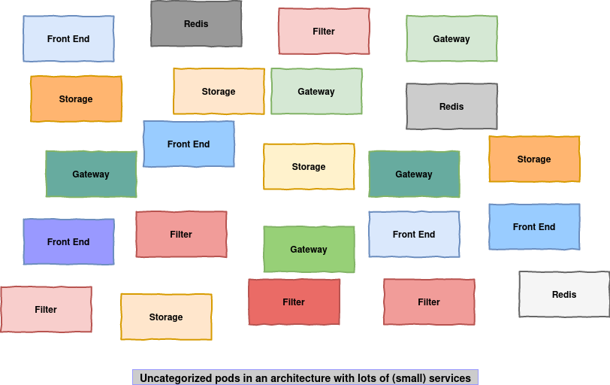
NEED TO TIDY UP?

Slide 112
ORGANIZE WITH LABELS
labels can be used to organize and select subsets of objects
The purpose of labels is to be able to position attributes on Kubernetes objects These attributes are useful for k8s users but have no value for k8s itself
labels can be attached to objects when creating them or added/removed later Each object can have a set of labels in the form key/value
Each key must be unique for a given object

Slide 113
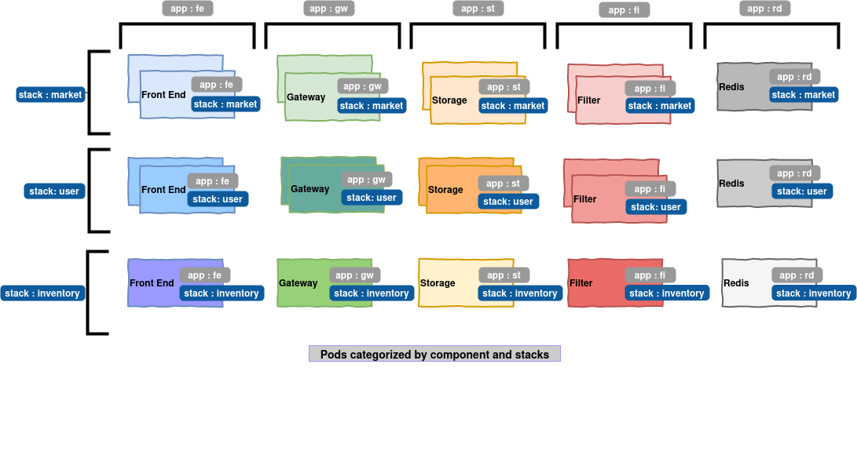
EXAMPLE OF ORGANIZATION WITH LABELS

Slide 114
SYNTAX AND ALLOWED CHARACTERS FOR LABELS
labels are key/value pairs :
prefix/name: value
Key: 2 sub-parts, 1 optional prefix and a name, separated by a slash (/)
Name is required and must be less than 63 characters, start and end with an alphanumeric, and may contain hyphens (-), underscores (_), periods (.), and others alphanumeric
The prefix is optional
If specified, the prefix must be in the form of a DNS domain: a series of DNS labels, separated by periods and whose total length must not exceed 253 characters
Value: less than 63 characters, must start and end with an alphanumeric and may contain dashes (-), underscores (_), periods (.), and other alphanumerics

Slide 115
SYNTAX AND ALLOWED CHARACTERS FOR LABELS (EXAMPLES)
my-label | bitbox | ✅
nodevops.io/my-label | bitbox | ✅
orchestration | I_love_Kubernetes | ✅
/my-label | whatever | ❌
label-with-large-value | invalid-very-very-large-value-label-that- has-more-than-63-characters | ❌
value-does-not-start- with-alphanum | _anything | ❌

Slide 116

RECOMMENDED LABELS
There are many tools for visualizing Kubernetes resources. There are recommended labels that help ensure some sort of interoperability between all of these tools and provide a common way to describe Kubernetes resources.
app.kubernetes.io/name | Application name | mysql
app.kubernetes.io/instance | Unique name for this instance | mysql-int
app.kubernetes.io/version | Application version | 5.7.21
app.kubernetes.io/component | Type of component in architecture | database
app.kubernetes.io/part-of | Membership Stack | wordpress
app.kubernetes.io/managed-by | Tool used to manage the application | helm
Other common labels: https://kubernetes.io/docs/reference/labels-annotations-taints/

Slide 117
SPECIFY LABELS ON CREATION
---
apiVersion: v1 kind: Pod metadata:
name: k8s-rulez
labels: app.kubernetes.io/component: labs
nodevops.io/my-label: bitbox-rulez
app: shell-gateway spec:
containers:
name: shelly
image: debian:11-slim imagePullPolicy: Always command:
"bash"
- "-c"
"sleep infinity"

Slide 118
SPECIFY LABELS AFTERWARD
Use the kubectl label <resourceType> <resourceName> key=value command to add labels to an existing resource:
kubectl label pod k8s-rulez release=stable
To overwrite an existing key, use the --overwrite option:
kubectl label pod k8s-rulez release=unstable --overwrite
To delete a key, use the key- syntax:
kubectl label pod k8s-rulez release-

Slide 119
SHOW POD LABELS
It is possible to list the labels of a pod using the command
kubectl label pod <pod> --list
Labels are also visible through the kubectl describe command Or by adding the --show-labels option to kubectl get
kubectl get pod --show-labels
The --label-columns <key1>[,<key2>,...] (or -L) option allows to add a dedicated column for each specified key
kubectl get pods --label-columns app,run
NAME | READY | STATUS | RESTARTS | AGE | APP | RUN
training-shell | 1/1 | Running | 0 | 22h |  | training-shell
k8s-rulez | 1/1 | Running | 0 | 1h | shell-gateway
whoami-086vd | 1/1 | Running | 0 | 21h |  | whoami
whoami-5c05r | 1/1 | Running | 0 | 1d |  | whoami

Slide 120
SELECT PODS BASED ON THEIR LABELS (1/3)
List the Pods for which app is exactly shell-gateway
kubectl get pods --selector app=shell-gateway
NAME | READY | STATUS | RESTARTS | AGE
k8s-rulez | 1/1 | Running | 0 | 2h
List Pods for which app is different than shell-gateway
kubectl get pods -l 'app!=shell-gateway'
NAME | READY | STATUS | RESTARTS | AGE
training-shell | 1/1 | Running | 0 | 22h
whoami-086vd | 1/1 | Running | 0 | 22h
yaml-pod | 2/2 | Running | 0 | 6h

Slide 121
SELECT PODS BASED ON THEIR LABELS (2/3)
List Pods for which the label with the app key is defined
kubectl get pods --selector app
NAME | READY | STATUS | RESTARTS | AGE
k8s-rulez | 1/1 | Running | 0 | 2h
List Pods for which the label with the run key is not defined
kubectl get pods --selector '!run'
NAME | READY | STATUS | RESTARTS | AGE
k8s-rulez | 1/1 | Running | 0 | 2h

Slide 122
SELECT PODS BASED ON THEIR LABELS (3/3)
List Pods for which run has whoami or yaml-pod values
kubectl get pods --selector 'run in (whoami,yaml-pod)'
NAME | READY | STATUS | RESTARTS | AGE
whoami-086vd | 1/1 | Running | 0 | 22h
whoami-5c05r | 1/1 | Running | 0 | 1d
whoami-p83md | 1/1 | Running | 1 | 22h
yaml-pod | 2/2 | Running | 0 | 6h
List Pods for which run does not have whoami or yaml-pod values
kubectl get pods --selector 'run notin (whoami,yaml-pod)' NAME READY
training-shell 1/1
STATUS
Running Running Running
RESTARTS AGE
0 23h
0 2h
0 2h
k8s-rulez 1/1 testdnslabel 1/1

Slide 123
COMBINE SELECTORS
List Pods for which app is shell-gateway and app.kubernetes.io/component is labs
kubectl get pods --selector app=shell-gateway,app.kubernetes.io/component=labs
NAME | READY | STATUS | RESTARTS | AGE
k8s-rulez | 1/1 | Running | 0 | 2h

Slide 124
DEFINING LABELS ON A NODE
Labels are attributes that can be set on all types of Kubernetes resources
... including Nodes
To list the nodes, use the command kubectl get nodes
kubectl get nodes --show-labels
NAME | STATUS | ROLES | AGE | VERSION | LABELS
minikube | Ready | control-plane | 2m5s | v1.30.0 | kubernetes.io/arch=amd64,
 |  |  |  |  | kubernetes.io/hostname=minikube,
 |  |  |  |  | kubernetes.io/os=linux,
 |  |  |  |  | node-role.kubernetes.io/control-plane=

Slide 125
USING LABELS ON NODES
Positioning a label on a Node allows it to be typed
For example, you can add a label to specify that the node uses SSD disks, or that it has access to GPU resources
kubectl get nodes --label-columns ssd,GPU
NAME | STATUS | ROLES | AGE | VERSION | SSD | GPU
minikube | Ready | control-plane | 5m50s | v1.30.0 | true | false
# 1. Lister les nodes pour récupérer le nom
kubectl get nodes
# 2. Ajouter le label
kubectl label node NOM_DU_NODE cle=valeur

Slide 126
USING LABELS TO CONSTRAIN SCHEDULING
It is possible to constrain the placement of Pods on nodes with specific labels
To do this, use the nodeSelector directive in the spec section of the Pod definition
---
apiVersion: v1 kind: Pod metadata:
name: elastic-on-ssd
labels:
app: search-engine stack: elastic
spec:
nodeSelector: ssd: "true"
containers:
- name: elastic
image: elasticsearch:5

Slide 127


Slide 128
ANNOTATIONS (1/2)
In addition to labels, it is possible to attach annotations to Kubernetes objects
Unlike labels, annotations are not used to identify objects, i.e. it is not possible to make selections in relation to them
On the other hand, annotations can contain information whose size is larger than that of label values (reminder: 63 characters) and use characters prohibited in label values

Slide 129
ANNOTATIONS (2/2)
It is possible to list the annotations of a Pod with the command
kubectl annotate pod <pod> --list
The annotations are visible by using the command kubectl describe
⚠ but their value can be truncated if it is too large instead, use:
kubectl get pod <podName> --output=yaml|json

Slide 130
ADD AN ANNOTATION
The command kubectl annotate add annotations to a resource
kubectl annotate pod light-sleeper k8s.bitbox.com/created-by=cfurmaniak pod "light-sleeper" annotated
kubectl describe pod light-sleeper | grep Annotations Annotations: k8s.bitbox.com/created-by=cfurmaniak

Slide 131
EXAMPLES OF INFORMATION THAT CAN BE STORED IN ANNOTATIONS
Build number in CI/CD tool, release date and IDs, hash of images used, address of private registries
eg: buid-url: https://my-ci.my-company.tld/path/to/pipelines/log
Source, git branch, Pull|Merge Request number eg: scm-branch: master
List of dependencies (services)
URLs to tools for centralizing logs and metrics, monitoring or auditing tools
Teams responsible for the application, contact addresses (phone, email, slack channels, ...)

Slide 132
NAMESPACES
Kubernetes supports multiple virtual clusters hosted on the same physical cluster. These virtual clusters are called Namespaces
Namespaces allow objects to be separated into disjoint groups (which the use of labels cannot ensure)
Namespaces provide scope for object names
Resource names are unique within the same Namespace
But objects with the same name can exist in 2 separate Namespaces Cluster admins can allocate resource qu otas by Namespace

Slide 133
LIST NAMESPACES
To list existing Namespaces, use kubectl get namespace (or kubectl get ns)
kubectl get namespaces
NAME | STATUS | AGE
default | Active | 2d
kube-node-lease | Active | 2d
kube-public | Active | 2d
kube-system | Active | 2d
The default Namespace is called default

Slide 134
QUERY NAMESPACES
See detailed information about a Namespace:
kubectl describe namespace default Name: default
Labels: kubernetes.io/metadata.name=default
Annotations: <none> Status: Active
No resource quota.
No LimitRange resource.

Slide 135
CREATE NAMESPACES
Create a Namespace:
Command: kubectl create ns <namespace>
From a descriptor: kubectl apply -f my-ns.yml
⚠ Namespaces cannot contain a dot (.)
---
apiVersion: v1 kind: Namespace metadata:
name: sandbox labels:
env: tests

Slide 136
CREATE OBJECTS IN A NAMESPACE
To create an object from a descriptor which does not specify a Namespace:
kubectl apply -f file.yaml -n <insert-namespace-name-here>
The target Namespace can be specified in the descriptor via metadata.namespace :
---
apiVersion: v1 kind: Pod metadata:
name: k2000
namespace: bitbox labels:
app: knight-rider
nickname: kitt spec:
...
kubectl apply -f descriptor-with-ns.yaml

Slide 137
SPECIFY NAMESPACE
To specify the Namespace in which an object should be created or requested, specify the option --namespace=<namespace> (or -n <namespace>)
kubectl get pods --namespace kube-system
NAME | READY | STATUS | RESTARTS | AGE
coredns-5644d7b6d9-nn5tl | 1/1 | Running | 0 | 17m
etcd-minikube | 1/1 | Running | 0 | 16m
kube-addon-manager-minikube | 1/1 | Running | 0 | 16m
...
kubectl describe pod etcd-minikube -n kube-system
To display resources from all Namespaces, use the --all-namespaces or -A option

Slide 138
DELETING A NAMESPACE
⚠ Deleting a Namespace deletes all objects associated with the Namespace...
... it is not possible to delete the kube-system, default and kube-public Namespace
kubectl delete ns <insert-namespace-name-here>

Slide 139
CHANGE THE DEFAULT NAMESPACE
kubectl can connect to multiple clusters, the current cluster is visible with the command
kubectl config current-context
The current Namespace is given with
kubectl config get-contexts <currentContextName>
To change the Namespace of the current context (cluster):
kubectl config set-context <currentContextName> --namespace=<insert-namespace-name-here>
... or use kubectx and kubens

Slide 141
VIEWING LOGS
To view the logs of a Pod, use kubectl logs
To view the whoami container logs in the yaml-pod Pod:
kubectl logs yaml-pod --container whoami
To view the logs of all containers of all Pods with the label app=whoami:
kubectl logs --selector app=whoami --all-containers --prefix
Use --tail=10 to see only the last 10 lines Use --follow (or -f) to follow the logs
Use --since=5s|2m|3h to see logs more recent than the duration parameter
Use --previous to see logs of a previous container in case of CrashLoopBackOff

Slide 142
SECURITYCONTEXT
To launch a container with a different user and/or group, use the securityContext.
apiVersion: v1 kind: Pod metadata:
name: security-context-demo
spec:
securityContext: runAsUser: 1000
runAsGroup: 3000
fsGroup: 2000 containers:
name: sec-ctx-demo image: busybox:1.36 command: [ "id" ]
name: root
image: busybox:1.36 command: [ "id" ] securityContext:
runAsUser: 0

Slide 143
EXAMPLE
kubectl apply -f security-context-demo.yaml pod/security-context-demo created
kubectl logs security-context-demo -c sec-ctx-demo uid=1000 gid=3000 groups=2000
kubectl logs security-context-demo -c root uid=0(root) gid=3000 groups=2000

Slide 144
KUBECTL DEBUG
To debug running Pod, it is possible to launch an ephemeral container in this Pod Introduced in beta in 1.23, stable since 1.25
Example to create a debug container in the my-app Pod with the busybox:1.36 image
kubectl debug -it my-app --image=busybox:1.28 --target=whoami
Targeting container "whoami". If you don't see processes from this container it may be because the container runtime doesn't support this feature.
Defaulting debug container name to debugger-98jzs.
If you don't see a command prompt, try pressing enter.
/ hostname my-app
/ ps aux PID
USER
1 root
TIME COMMAND
0:00 /whoami # <== this is the processus of the whoami container!! 0:00 sh
0:00 ps aux
9 root
15 root

Slide 145
INIT CONTAINERS
A Pod can be made up of several containers for hosting the application It can also rely on one or more Init Containers
Init Containers are like containers except that: they have a limited lifespan
each of the Init Containers is only launched if the previous one completed without error
If an Init Container fails, k8s restarts the Pod until the Init Container exits with status success (unless the restartPolicy of the Pod is Never)
An alpha restartPolicy field for Init Containers is introduced in 1.28, and uses that to indicate when the Init Container is also a sidecar container

Slide 146
WHEN TO USE AN INIT CONTAINER?
They are launched before other containers and share the same Volume. They can be used for:
Generate the main application configuration in one-shot (with consul-template or vault- age nt for example)
Perform operations requiring privileges and lower the level of privilege required in the application container
Implement database migration or database update
Wait for a dependency to be ready or for preconditions to be met

Slide 147
INIT CONTAINER EXAMPLE
---
apiVersion: v1 kind: Pod metadata:
name: myapp-pod
spec:
initContainers:
name: wait-for-mydb image: busybox:1.36
command: ['sh', '-c', 'until nslookup mydb; do echo waiting for mydb; sleep 2; done;']
name: init-db
image: flyway/flyway:10 command: ['migrate', '......']
containers:
name: back
image: ghcr.io/traefik/whoami:v1.10.1

Slide 149


QUIZZ
1 | Can one Pod be deployed across multiple Namespaces ❓
2 | Is it possible to add a new container to a running Pod ❓
3 | Can Label be update after the creation of a Pod ❓
4 | Can Namespaces be used to restrict access to resources for certain users or groups❓
5 | Should Pods be scheduled on a specific Node ❓
6 | A Pending state on a Pod mean it is crashed❓
7 | There is as many IP addresses as containers in a Pod ❓
8 | Can I rollback the deletion of a Namespace ❓

Slide 150
PODS LIFECYCLE
Pods are ephemerals (i.e., they can be deleted) They are created, but not recreated automatically
It is the work of the Controllers that we will see later
On the other hand, if one of the containers managed by the Pod dies it is the responsibility of the Pod to restart it (depending on the restartPolicy selected for the Pod)

Slide 151
LIVENESS
But how to detect that the application is not working when the associated container does not die?
A Java application with a memory problem can send OutOfMemoryErrors, but the JVM is not terminated!
... and what to do if your application is in an infinite loop or a deadlock situation?
ℹ Kubernetes provides the concept of Liveness Probe ("life probe") to address this problem

Slide 152
CONTAINER PROBES (1/2)
A probe is a diagnostic performed by Kubernetes (by the kubelet component) on a container There are 4 types of probes:
httpGet: a GET call is made, a status code >= 200 and < 400 is considered a success tcpSocket: if the concerned port is open, the probe is success
grpc: if the server is able to handle rpcs onto a specific port, it is a success
exec: a command is carried out in the concerned container, a return code of 0 is equivalent to a success
Notes:
Dans Kubernetes, une probe, c’est comme un petit check-up de santé que le kubelet fait régulièrement sur un container. L’idée, c’est de vérifier automatiquement si l’application est vivante et en bon état, sans intervention humaine.
Kubernetes propose 4 types de probes :
httpGet Là, Kubernetes envoie une requête HTTP GET vers ton container, sur une URL et un port que tu définis. Si le container répond avec un code HTTP entre 200 et 399, la probe est considérée comme success. Au‑delà ou en-dessous, c’est un échec.
tcpSocket Ici, Kubernetes essaie juste d’ouvrir une connexion TCP sur un port donné. Si le port est ouvert et accepte la connexion, la probe est success. Si ça ne répond pas, la probe échoue.
grpc Pour les applications qui exposent un serveur gRPC, Kubernetes peut envoyer une requête gRPC spéciale (health check) sur un port. Si le serveur accepte et répond correctement aux RPC sur ce port, la probe est success.
exec Dans ce cas, Kubernetes exécute une commande à l’intérieur du container (par exemple curl, pg_isready, etc.). Si la commande retourne un code de sortie 0, c’est un succès. Tout autre code signifie échec.
En combinant ces probes, Kubernetes peut décider de redémarrer un container, de retirer un Pod du Service (pas prêt) ou de le laisser recevoir du trafic. C’est la base de l’auto‑réparation et de la haute disponibilité dans un cluster.

Slide 153
CONTAINER PROBES (2/2)
Probes are used to verify that a container is started (Startup Probe), running (Liveness Probe) or is ready to receive traffic (Readiness Probe)
We will cover Readiness Probe in the next chapter, Services
Only one probe of each type (httpGet, tcpSocket, grpc, exec) can be defined for each category (Startup/Liveness/Readiness) per container

Slide 154
PROBE CONFIGURATION
---
apiVersion: v1 kind: Pod metadata:
name: whoami
labels:
test: liveness spec:
containers:
- name: whoami
image: traefik/whoami:v1.10 livenessProbe:
httpGet:
path: /healthz port: 8080
initialDelaySeconds: 15
timeoutSeconds: 1

Slide 155
ADDITIONAL PARAMETERS OF A PROBE
initialDelaySeconds: delay before starting to run the first diagnostics (default: 0, minimum: 0)
timeoutSeconds: maximum time allowed to receive the response. If the response is not retrieved within the timeout, the probe fails (default: 1, minimum: 1)
periodSeconds: period between diagnostic executions (default: 10, minimum: 1)
successThreshold: minimum number of successes for the probe to be considered in
success state (default: 1, minimum: 1, must be 1 for Startup Probe and Liveness Probe)
failureThreshold: minimum number of failures for the probe to be considered in fail
state (default: 3, minimum: 1)

Slide 156
CONTAINER START DELAY
It may happen that a container takes a long time to start (if for example there is very little CPU for the Pod) and it would then be necessary to put a long initialDelaySeconds
But this delays the detection time of a functional container by the same amount
Since version 1.16 there is a Startup Probe to detect that the container is not ready yet
startupProbe: httpGet:
path: /healthz
port: 8080
failureThreshold: 30
periodSeconds: 10
initialDelaySeconds: 15
This will wait at most initialDelaySeconds + (failureThreshold * periodSeconds) for the container to start and, if successful, move to the Liveness Probe in order to check its status

Slide 157
DISPLAY OF PROBE STATUS
The kubectl describe pod command returns information about potential failed probes (and associated restarts)
Events:
Type Reason Age
From
Message
...
Warning Unhealthy 2m7s (x8 over 3m47s) kubelet Liveness probe failed: HTTP probe failed with statuscode: 500
Normal Killing 2m7s (x4 over 3m37s) kubelet Container i-am-alive failed
liveness probe, will be restarted
...
ℹ When a container is killed, a completely new container is created, it’s not just the same container being restarted

Slide 158
ANATOMY OF A GOOD LIVENESS PROBE
It is strongly recommended to set up Liveness Probes for your Pods in production because if not, k8s has no way of knowing if your applications are working as expected
A probe (http) should correspond to a dedicated path in your application and correspond to an internal operating diagnosis
A probe must not be affected by your application's dependencies: it is your dependencies that are in error, not your application!
it's up to you to properly manage the dependencies in error in your application (use
circuit breaker for example)
Keep your probes light: they must respond quickly and without consuming too much cpu
and memory so as not to disrupt the operation of your application

Slide 160
RESOURCE HANDLING
When creating a Pod you should define:
The CPU and memory amount needed by each of its containers (Requests)
The maximum amount of these two resources which can not be exceeded (Limits) Resources used by a Pod is the sum of resources used by all of its containers

Slide 161
EXAMPLE
---
apiVersion: v1
kind: Pod
metadata:
name: frontend
spec:
containers:
- name: app
image: super.mycompany.com/app:v4
resources:
requests:
memory: "256Mi"
cpu: "500m"
limits:
memory: "2Gi"
cpu: "2"

Slide 162
SCHEDULE AND REQUESTS
When you create a Pod, the scheduler selects a node to host it Each node has a max capacity (CPU and Memory)
The scheduler ensures that the sum of the Requests of the Pods on a node does not exceed the capacity of the node
⚠ it is not the current CPU/Memory consumption of the node at the time of scheduling that is used but the sum of the Requests of the Pods of the node
Then:
You can define Quotas on Namespaces
You can add LimitRange which will apply default values for containers

Slide 163
MEMORY LIMITS IN PRACTICE
A container may consume more memory than the request made if the node hosting it has enough available memory
A container cannot consume more than the defined limit
If a container allocates more memory than the limit then this container will be marked as a candidate for termination. If it continues to consume more memory than the limit value then it will be terminated.
If it is restartable, the kubelet will try to restart it (this is an error case like the others)

Slide 164
CPU LIMITS IN PRACTICE
A container may consume more cpu than the request made if the node hosting it has enough CPU resources available
A container cannot consume more than the defined limit: it is throttle

Slide 165
CPU LIMITS: EXAMPLE
---
apiVersion: v1
kind: Pod
metadata:
name: cpu-demo
spec:
containers:
- name: cpu-demo-ctr
image: bitboxtraining/k8s-training-stress:v3
resources:
limits:
cpu: "1"
requests:
cpu: "0.5"
args:
- --vm
- "2"

Slide 166
CPU UNIT (1/2)
The CPU resource is measured in cpu units
1 CPU Unit means: 1 AWS vCPU
1 GCP Core
1 Azure vCore
1 Hyperthread of an Intel processor of a bare metal server with Hyperthreading

Slide 167
CPU UNIT (2/2)
A container that requires 0.5 cpu is guaranteed to have half the cpu of a container that requires 1 cpu
It is possible to use the suffix m which means milli
100m cpu, 100 millicpu, and 0.1 cpu represent the same value
The value of a CPU unit is an absolute value: 0.1 corresponds to the same amount of CPU on a single-core, dual-core, or a 48-core machine

Slide 168
NODE RESOURCES (1/3)
kubectl describe nodes e2e-test-minion-group-4lw4 Name: e2e-test-minion-group-4lw4
Capacity: cpu: memory: pods:
Allocatable:
cpu: memory: pods:
2
7679792Ki
110
1800m
7474992Ki
110
...

Slide 169
NODE RESOURCES (2/3)
...
Non-terminated Pods: Namespace Name
(5 in total) CPU Requests
CPU Limits
Memory Requests
Memory Limits
kube-system | fluentd-g... | 100m | (5%) |  | 0 (0%) |  | 200Mi (2%) |  | 200Mi (2%)
kube-system | kube-dns-... | 260m | (13%) |  | 0 (0%) |  | 100Mi (1%) |  | 170Mi (2%)
kube-system | kube-prox... | 100m | (5%) |  | 0 (0%) |  | 0 (0%) |  | 0 (0%)
kube-system | monitorin... | 200m | (10%) |  | 200m (10%) |  | 600Mi (8%) |  | 600Mi (8%)
kube-system
...
node-prob...
20m (1%)
200m (10%)
20Mi (0%)
100Mi (1%)

Slide 170
NODE RESOURCES (3/3)
...
Allocated resources:
(Total limits may be over 100 percent, i.e., overcommitted.) CPU Requests CPU Limits Memory Requests Memory Limits
680m (34%) 14000m (200%) 920Mi (12%) 1070Mi (14%)
We also recommend to use great projects like kube-cap acity, kube-resource-report or kube- resource-recomandations.

Slide 172
LIMITRANGES (1/2)
It is possible to configure by Namespace: default values for requests and limits max values for requests and limits

Slide 173
LIMITRANGES (2/2)
---
apiVersion: v1 kind: LimitRange metadata:
namespace: shopping
name: mem-limit-range spec:
limits:
- default: # default value for `limits` memory: 512Mi
cpu: 200m
defaultRequest: # default value for `request` memory: 256Mi
cpu: 100m
min:
memory: 200Mi cpu: 50m
max:
memory: 1Gi cpu: 1
type: Container
# minimum allowed for `limits`
# maximum allowed for `limits`

Slide 174
RESOURCEQUOTA
It is also possible to limit the total resource usage in a Namespace with a ResourceQuota
---
apiVersion: v1 kind: ResourceQuota metadata:
namespace: shopping
name: compute-resources spec:
hard:
requests.cpu: "1" requests.memory: 1Gi limits.cpu: "2" limits.memory: 2Gi

Slide 175
DISPLAY LIMITRANGE AND RESOURCEQUOTA
The LimitRange and ResourceQuota are shown on the Namespace:
kubectl describe namespace shopping
Name:
shopping kubernetes.io/metadata.name=shopping
<none>
Active
Labels: Annotations: Status:
Resource Quotas Name: Resource
compute-resources Used Hard
limits.cpu | 0 |  | 2
limits.memory | 0 |  | 2Gi
requests.cpu | 0 |  | 1
requests.memory | 0 |  | 1Gi
Resource Limits
Type | Resource |  | Min | Max |  | Default | Request |  | Default | Limit |  | Max Limit/Request | Ratio
Container | cpu |  | 50m | 1 |  | 100m |  |  | 200m |  |  | -
Container | memory |  | 200Mi | 1Gi |  | 256Mi |  |  | 512Mi |  |  | -

Slide 176
QUIZZ
1 | Can the configuration of a Pod be dynamically updated ❓
2 | Can Pods share their network with other Pods ❓
3 | Are Pods scheduled on a Node based on available Memory and CPU ❓
4 | Can container in a Pod run as root ❓
5 | Do Pods have their own lifecycle independent of the containers they contain ❓
6 | Are Pods automatically restarted by Kubernetes if their underlying node fails ❓

Slide 178
CONTROLLERS
6
© Copyright 2024 bitbox. All rights reserved
2024-12-15#547bc88

Slide 179
AGENDA
ReplicaSets DaemonSets Jobs

Slide 180
INTRODUCING CONTROLLERS (1/2)
Let's recap:
k8s makes sure our containers are running and restarts them if the main process dies or the
liveness probe fails
This task is handled by kubelet component which runs on each worker node
The Kubernetes control center running on dedicated nodes plays no role in this part

Slide 181
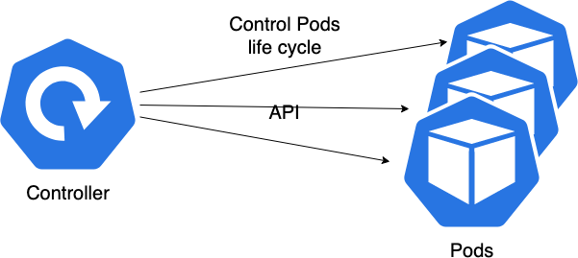
INTRODUCING CONTROLLERS (2/2)
What happens if the Node hosting the Pods goes down?
To ensure that our application/Pod can be restarted on another node, we must rely on a higher level mechanism than the Pod
These mechanisms, called Controllers, are the ReplicaSets, DaemonSets, Jobs and CronJobs

Slide 182
REPLICASET
A ReplicaSet is a Kubernetes resource which role is to ensure that a Pods is created If a Pods disappears/dies for any reason:
a failing Node
the Pods was removed from a Node during maintenance
... the ReplicaSet will detect the absence of the Pods and cause a new one to be created

Slide 183
REPLICAS (1/2)
a ReplicaSet can manage several copies (called replicas) of the same Pods and ensure that the number of replicas in operation corresponds to the expected one:
if there are not enough replicas compared to the target, the ReplicaSet will create the missing ones
if there are too many, it will delete some to get the requested number

Slide 184
REPLICAS (2/2)
a ReplicaSet relies on a selector of labels to identify the Pods it must manage
a ReplicaSet is similar to a process monitor, but instead of monitoring processes on a single node, it can monitor multiple Pods on multiple nodes
it is highly recommended to use a ReplicaSet even if you only need to manage one Pod

Slide 185
REPLICASET EXAMPLE
---
apiVersion: apps/v1 kind: ReplicaSet metadata:
name: rs-nginx
spec:
replicas: 3 selector:
matchLabels:
app: nginx template:
metadata:
name: pod-nginx labels:
app: nginx
spec:
containers:
- name: container-nginx image: nginx:stable-alpine ports:
- containerPort: 80

Slide 186
CONTENT OF A REPLICASET DESCRIPTOR
the apiVersion, kind and metadata sections are similar to what is found for all k8s resources
the specs section contains:
the expected number of replicas
the selector used to identify the associated Pods the template to use for the creation of the Pods

Slide 187
PODS SELECTOR AND REPLICASET (1/2)
The .spec.selector field is a label selector
The ReplicaSet will manage all Pods that match this selector
⚠ The ReplicaSet does not differentiate between the Pods it has created/deleted and those that another process has created/deleted (if they are not within the scope of a ReplicaSet [see Lab])

Slide 188
PODS SELECTOR AND REPLICASET (2/2)
The .spec.selector field must be specified, it must correspond to the labels of the Pods template (.spec.template.metadata.labels)
If the .spec.selector field is specified and does not match the Pods template labels (.spec.template.metadata.labels), the creation will be refused
kubectl apply -f ~/workspaces/Lab3/rs--nginx-cannot-create--3.1.yml The ReplicaSet "frontend" is invalid: spec.template.metadata.labels:
Invalid value: map[string]string{"app":"frontend", "level":"advanced"}: `selector`
does not match template `labels`

Slide 189
REPLICASET SELECTOR
The ReplicaSet selector can use 2 kinds of selector: matchLabels: simple key=value selection matchExpressions: advanced selections:
level label with value novice or intermediate
level label key defined, whatever the value is

Slide 190
REPLICASET SELECTOR EXAMPLE
---
apiVersion: apps/v1 kind: ReplicaSet metadata:
name: frontend
labels:
app: frontend spec:
replicas: 3
selector: matchLabels:
app: frontend
matchExpressions:
key: level operator: In values:
novice
intermediate template:
...

Slide 191
OPERATORS, MATCHLABELS AND MATCHEXPRESSIONS
There are 4 operators available:
In (values must also be specified)
NotIn (values must also be specified)
Exists (values must not be specified)
DoesNotExist (values must not be specified)
If matchLabels and matchExpressions are both specified, the labels must match the 2 constraints

Slide 192
MODIFICATIONS OF THE LABELS OF THE PODS OR THE TEMPLATE
If you modify the labels of a Pods managed by a RS it will not be handled by the RS anymore
⚠ The ReplicaSet does not control the content of a Pod, if you modify the model of the Pods of an RS, only the new Pods created will be affected
However, there is a way to force the Pods to update, we will see this in the chapter Deployment strategies

Slide 193
KUBECTL AND REPLICASETS
kubectl get replicasets or (shorter !) kubectl get rs kubectl describe rs <rsName> to see the detailed info kubectl scale rs <rsName> --replicas=N to scale the RS
kubectl delete rs <rsName> to delete a RS: take care, it will also remove associated Pods
If you want to delete the RS without deleting associated Pods, use
kubectl delete rs <rsName> --cascade=orphan

Slide 194
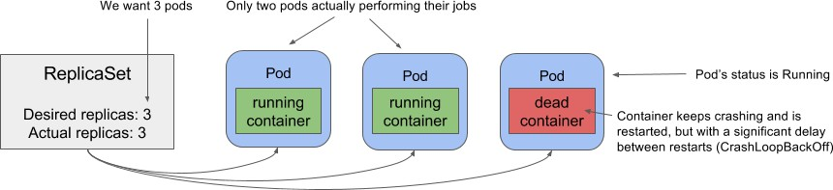
REPLICASET AND CRASH LOOPING PODS
Take care, the ReplicaSet is responsible for having a number of Pods up But if a container crashes every 5 minutes, it's not his problem!

Slide 195


Slide 196
DAEMONSETS
ReplicaSets are used to spin up a set number of Pods anywhere on the cluster
Another use case exists: running one and only one copy of a Pods on each Node (or on a defined subset of nodes)
To answer this problem, let's use a DaemonSet

Slide 197
USE CASES FOR DAEMONSETS
Run a storage daemon on each Node (glusterd, ceph, rook, ...) Run a log collection agent (fluentd, logstash, filebeat...)
Run a metrics collection agent (Prometheus, collectd, datadog, ganglia, ...)

Slide 198
DIFFERENCES BETWEEN REPLICASET AND DAEMONSET
A ReplicaSet ensures that a desired number of replicas of a Pods are running on the cluster: If a Node is added to the cluster, nothing happens
If a Node is removed from the cluster, any Pods scheduled on this Node will be reassigned to other nodes
A DaemonSet ensures that one and only one instance of Pods runs on each Node (or subset of nodes)
If a Node is added to the cluster, a new Pods will be launched on the new node
a DaemonSet will be deployed even on nodes marked as unusable (by administrators) If a Node is removed from the cluster, no new Pods will be launched

Slide 199
DAEMONSET ON A SUBSET OF NODES
A DaemonSet deploys its Pods on all cluster nodes...
... unless you specify on which nodes to deploy through a nodeSelector
use cases: specific tools depending on the hardware of each node

Slide 200
DAEMONSET DESCRIPTOR
---
apiVersion: apps/v1 kind: DaemonSet metadata:
name: ssd-monitor
spec:
selector: matchLabels:
app: ssd-monitor
template: metadata:
labels:
app: ssd-monitor spec:
nodeSelector:
disk: ssd containers:
- name: main
image: ssd/ssd-monitor-agent:v3

Slide 202
DEPLOYMENT STRATEGIES
10
© Copyright 2024 bitbox. All rights reserved
2024-12-15#547bc88

Slide 203
AGENDA
Deploying a new Pod version Rolling Update

Slide 204
DEPLOYING A NEW POD VERSION
There are more than one strategy to update a set of Pods

Slide 205
REPLICASET FTW (1/2)
Step 1: update the ReplicaSet descriptor
Step 2: delete the Pods corresponding to the old version Step 3: wait

Slide 206
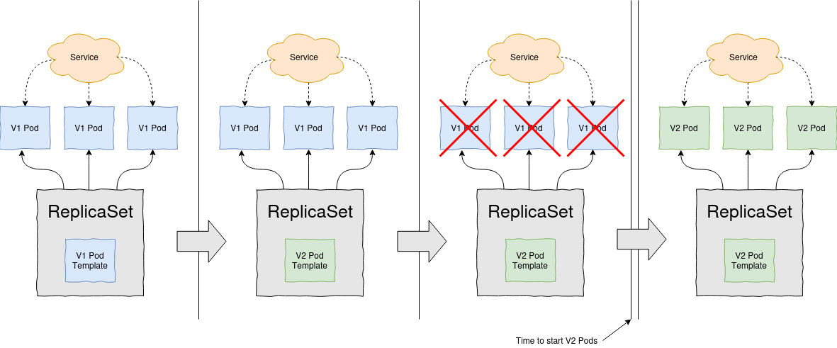
REPLICASET FTW (2/2)
Drawback: requires a service downtime while the ReplicaSet creates the Pods from the new template

Slide 207
REPLICASET + SERVICE (1/2)
Step 1: create another ReplicaSet for the new version
Step 2: wait for all the Pods to be READY, change the selector of the Service Step 3: delete the ReplicaSet handling the old version

Slide 208
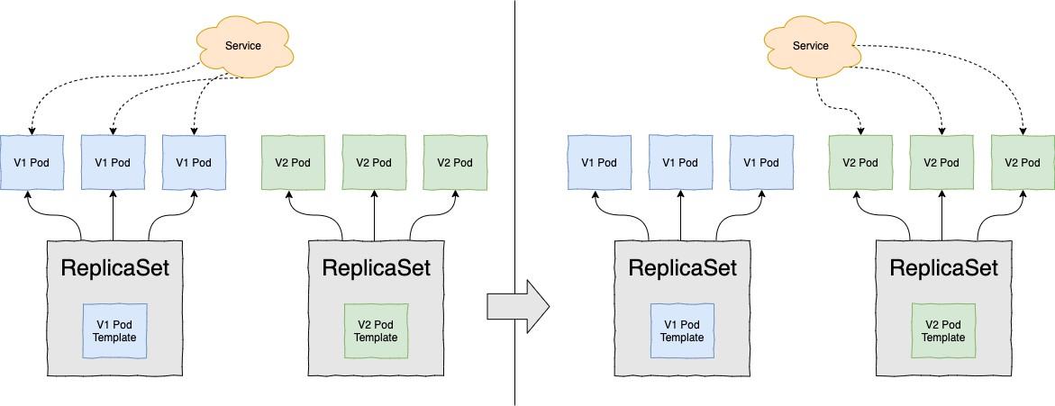
REPLICASET + SERVICE (2/2)
Drawback: requires enough resources to handle 2 revisions of the application at the same time

Slide 209
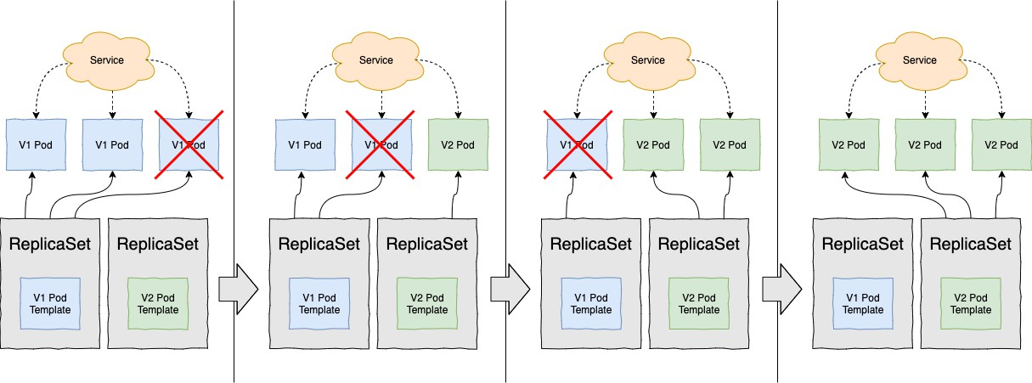
MANUAL ROLLING UPDATE
Drawback: requires a lot of manual operations... and as such it's error prone!

Slide 210
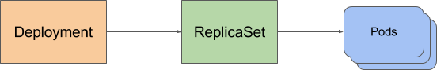
DEPLOYMENT FTW !
A Deployment provides declarative updates for Pods and ReplicaSets.

Slide 211
DEPLOYMENT DESCRIPTOR
---
apiVersion: apps/v1 kind: Deployment metadata:
name: bitbox
spec:
replicas: 3 selector:
matchLabels:
app: bitbox strategy:
type: RollingUpdate
rollingUpdate: maxSurge: 1
maxUnavailable: 0
template: metadata:
labels:
app: bitbox spec:
containers:
- name: app
image: bitbox/k8s-training-deploy:v1

Slide 212
DEPLOYMENT STATUS
How to check if the Deployment went well?
kubectl apply -f bitbox-deployment-v1.yml
kubectl rollout status deployment bitbox deployment bitbox successfully rolled out
kubectl get deployment -l app=bitbox
NAME | DESIRED | CURRENT | UP-TO-DATE | AVAILABLE | AGE
bitbox | 3 | 3 | 3 | 3 | 16m
kubectl get replicaset -l app=bitbox
NAME DESIRED CURRENT | READY | AGE
bitbox-3842228658 3 3 | 3 | 24s
kubectl get pods -l app=bitbox
NAME | READY | STATUS | RESTARTS | AGE
bitbox-3842228658-l0jwc | 1/1 | Running | 0 | 54s
bitbox-3842228658-pd3s9 | 1/1 | Running | 0 | 54s
bitbox-3842228658-s5ww2 | 1/1 | Running | 0 | 54s

Slide 213
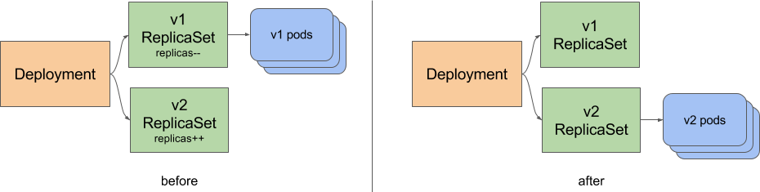
UPDATING
Update to v2 :
kubectl apply -f bitbox-deployment-v2.yml deployment.apps/bitbox configured
kubectl get replicaset -l app=bitbox
NAME | DESIRED | CURRENT | READY | AGE
bitbox-3842228658 | 0 | 0 | 0 | 2m
bitbox-43373277 | 3 | 3 | 3 | 52s

Slide 214
OTHER DEPLOYMENT RELATED COMMANDS
kubectl rollout history deploy frontend deployments "frontend"
REVISION CHANGE-CAUSE
17
18
19
20
21
kubectl apply --filename=frontend-b1386-d1387.yml kubectl apply --filename=frontend-b1391-d1392.yml kubectl apply --filename=frontend-b1405-d1407.yml kubectl apply --filename=frontend-b1409-d1410.yml kubectl apply --filename=frontend-b1414-d1415.yml
kubectl rollout undo deployment frontend ‐‐to‐revision=20

Slide 215
CONTROLLING THE "ROLLOUT" PROCESS
maxSurge (default 25%): how many Pod instances in excess of the target replicas are allowed, the value is rounded up.
if replicas=4, there will never be more than 5 "ready" Pods
maxUnavailable (default 25%): how many Pod instances can be unavailable relative to the target replicas, the value is rounded down.
if replicas=4, there will never be less than 3 "ready" Pods
spec:
strategy:
type: RollingUpdate rollingUpdate:
maxSurge: 30%
maxUnavailable: 0

Slide 216
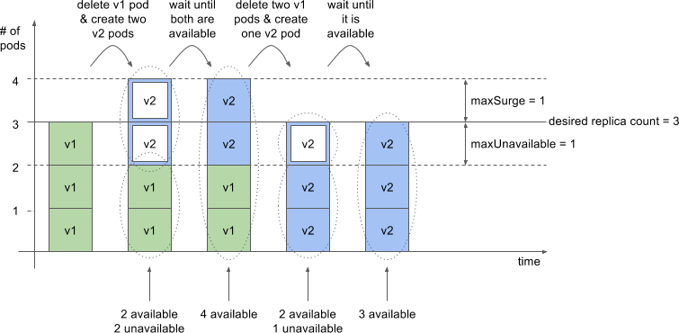
REPLICAS=3, MAXSURGE=1, MAXUNAVAILABLE=1

Slide 217
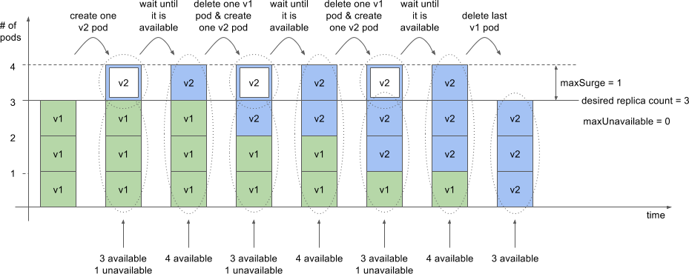
REPLICAS=3, MAXSURGE=1, MAXUNAVAILABLE=0

Slide 218
RECREATE STRATEGY
If the application should not have two different versions deployed at the same time, use the
Recreate strategy
Delete all existing Pods
Create new Pods
spec:
strategy:
type: Recreate
⚠ This strategy implies downtime for your service.

Slide 219
DEPLOYMENT STRATEGIES - SUMMARY
Kubernetes natives strategies with Deployments:
Recreate: service downtime, during the new version startup
Ramped / Rolling update: progressive replacement of older replicas by new ones Strategies requiring additional configuration:
Blue/Green: switch between the 2 versions at a given moment
Canary: validate the new version with an identified subset of users before a full rollout
A/B testing: validate the new version with a traffic percentage before a full rollout Shadow: traffic duplication to the new version, ignoring the response

Slide 220


Slide 222
SERVICE AND NETWORK EXPOSITION
7
© Copyright 2024 bitbox. All rights reserved
2024-12-15#547bc88

Slide 223
AGENDA
What is the concept of Services Expose inside the cluster Expose to external client Readiness probe
Headless Services Port forward
Secure Services inside a cluster

Slide 224
WHAT IS THE CONCEPT OF SERVICES?
Pods are ephemeral (they can be deleted or moved)
Kubernetes assigns an IP address to the Pod just before its creation, so it is not possible to know it in advance
Scaling a ReplicaSet implies that several Pods host the same application and therefore provide the same service
Clients of these applications should not have to know the IPs of the different Pods they consume
To solve these problems, Kubernetes provides a resource called Service which we will explore in this chapter

Slide 225
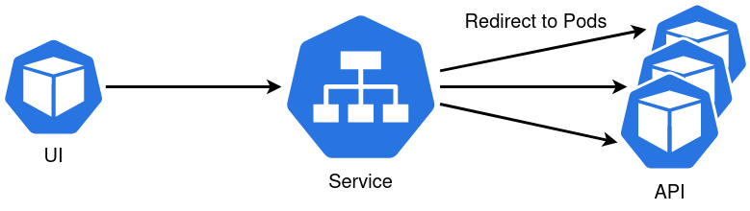
INTRODUCTION TO SERVICES
A Kubernetes Service is a resource you create to provide a single, consistent entry point for a group of Pods that host the same application
Each Service has an IP address (and an associated port) which does not change as long as the Service exists
Clients can open connections to this pair IP:port and these connections will be redirected to the Pods composing the application
This way customers don't need to know the IPs of the Pods that make up the application, allowing those Pods to be moved/deleted without impacting customers

Slide 226
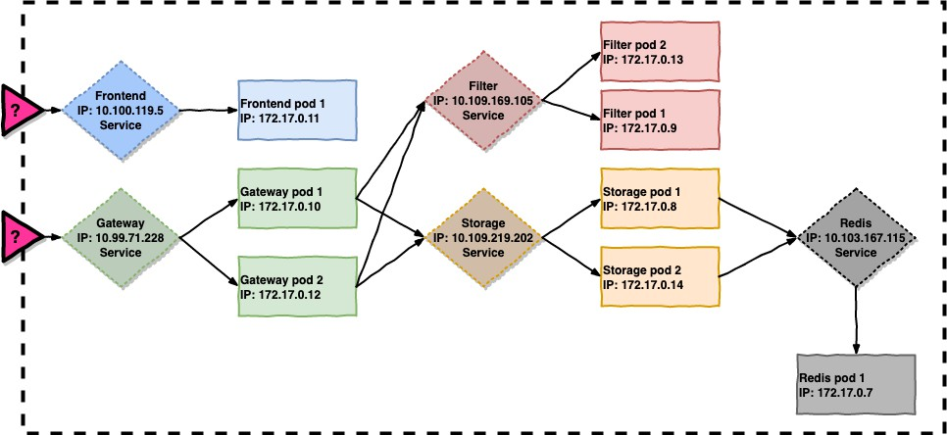
SERVICES USAGE EXAMPLES

Slide 227
SERVICE DESCRIPTOR (1/2)
---
apiVersion: v1 kind: Service metadata:
name: whoami
spec:
selector: app: whoami
stack: market
ports:
- protocol: TCP port: 8080
targetPort: 80
This descriptor creates a Service that listens on port 8080 and will distribute traffic between all Pods that match app=whoami,stack=market on port 80.
The Service will be assigned an internal IP called ClusterIP

Slide 228
SERVICE DESCRIPTOR (2/2)
You can also use kubectl expose to generate code from an existing Replicaset (or Deployment)
kubectl expose rs/nginx --dry-run=client -o yaml apiVersion: v1
kind: Service
metadata: creationTimestamp: null name: nginx
spec:
ports:
- port: 80 protocol: TCP targetPort: 80
selector:
app: nginx level: novice
status:
loadBalancer: {}

Slide 229
EXPOSE INSIDE THE CLUSTER
By default, if the .spec.type value of a Service is not specified, the type will be ClusterIP
Choosing this value allows you to ensure that the Service will not be accessible from outside the Kubernetes cluster
⚠ It is impossible to "ping" a Service because:
ping uses the ICMP protocol which is not supported by Kubernetes Services (only TCP, UDP
and SCTP protocols are supported)
it is not possible to specify a destination port with the ping command, but the Service is only accessible on the declared ports

Slide 230
EXPOSE MULTIPLE PORTS FOR THE SAME SERVICE
Services can expose multiple ports (which must then be named)
For example, an application can expose the main port and the administration port When the ports are named, we can refer to the name rather than its value
---
apiVersion: v1 kind: Service metadata:
name: simple-springboot
spec:
selector:
app: simple-springboot ports:
name: main
port: 80
targetPort: 8080
name: admin port: 8000
targetPort: 8081

Slide 231
SERVICE DISCOVERY
Using the ClusterIP to communicate with the Service is not very convenient Use the DNS address of the Service:
FQDN: <service-name>.<namespace>.svc.cluster.local
shorter: <name-of-the-service>.<namespace>
within the same Namespace, each Service can even be directly addressed simply by its name: <name-of-the-service>

Slide 233
HOW DOES A SERVICE WORK, ACTUALLY?
kubectl describe service whoami Name: whoami
Namespace: default
Labels: app=whoami stack=market
Selector: app=whoami,stack=market
Type: ClusterIP
IP: 10.0.0.72
Port: <unset> 8080/TCP
TargetPort: 80/TCP
Endpoints: 172.17.0.8:80,172.17.0.9:80
Session Affinity: None

Slide 234
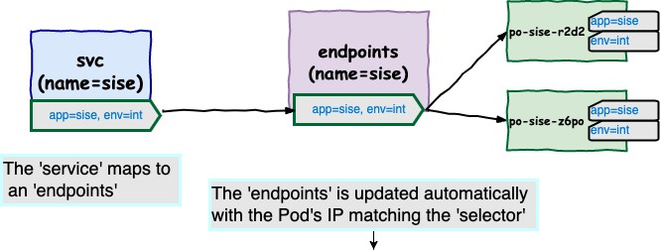
ENDPOINTS
kubectl get endpoints whoami
NAME
ENDPOINTS AGE
172.17.0.8:80,172.17.0.9:80 3m
whoami

Slide 235
EXPOSE A SERVICE TO EXTERNAL CLIENT
For the moment we have only covered consumption of Service by Pods of the cluster itself
It is of course possible to expose the Service so that they are accessible by clients external to the cluster

Slide 236
HOW?
Use a NodePort type Service
Use a Service of type LoadBalancer
Create an Ingress type resource

Slide 237
NODEPORT SERVICES (1/3)
---
apiVersion: v1 kind: Service metadata:
name: whoami-nodeport
spec:
type: NodePort selector:
app: whoami
ports:
- nodePort: 30123
port: 8080
targetPort: 80
Kubernetes will allocate a port on all its nodes (the same on all nodes) and redirect the traffic that reaches this port to the concerned Service
Note: a ClusterIP will also be created for internal communication

Slide 238
NODEPORT SERVICES (2/3)
kubectl get svc whoami
NAME | TYPE | CLUSTER-IP | EXTERNAL-IP | PORT(S) | AGE
whoami | NodePort | 10.0.0.72 | <none> | 8080:30123/TCP | 52m
The NodePorts available range is predefined at the cluster level (by default 30000-32767)
It is possible to omit the value of .spec.ports.nodePort, Kubernetes will automatically assign a free one

Slide 239
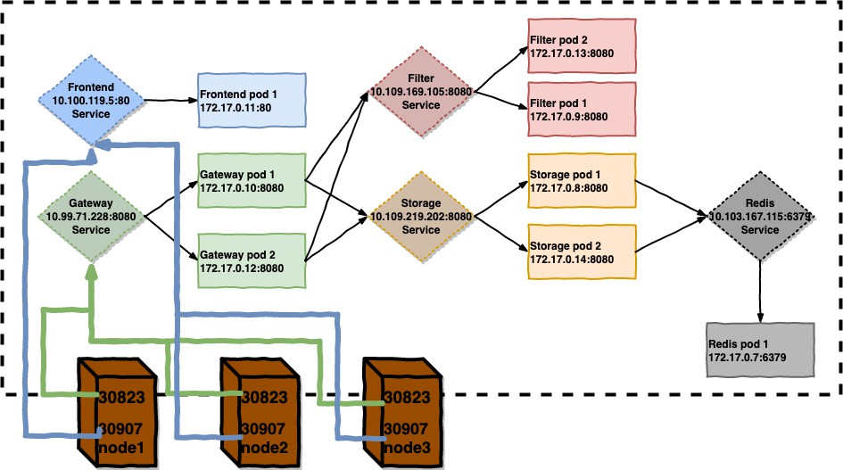
NODEPORT SERVICES (3/3)
kubectl get services
svc/frontend | NodePort | 10.100.119.5 | <none> | 80:30907/TCP
svc/gateway | NodePort | 10.99.71.228 | <none> | 8080:30823/TCP

Slide 240
LOADBALANCER SERVICES
Some Cloud service providers provide Kubernetes integration with their internal LoadBalancing features (NLB on AWS, Azure, GCP)
By setting the .spec.type to LoadBalancer, Kubernetes will interact with the Cloud Provider API and automatically provision/configure a loadbalancer associated with the Service
This configuration/provision is asynchronous
LoadBalancer configuration information only appears when configuration is complete
Technically, the created LoadBalancer redirects traffic to the Service through a NodePort which is associated with the Service (which you don't have to create yourself)

Slide 242
WHY DO WE NEED AN ADDITIONAL MECHANISM?
Not all Kubernetes clusters are configured to dynamically create LoadBalancers Exposing Services through NodePort is not very practical
You can also optionally configure a LoadBalancer not driven by Kubernetes (HAProxy, F5, ...)
... if you have access to it
The Services operate at the TCP layer and do not allow practices such as cookie affinity or other configurations made at the HTTP level
The Ingress, yes 🙂

Slide 243
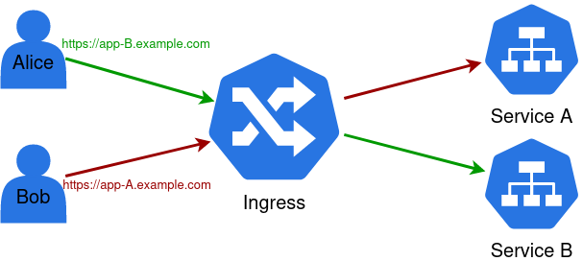
OTHER INGRESS ADVANTAGES
Each LoadBalancer type Service requires its own loadbalancer (in the cloud service instance meaning) and its own IP
An Ingress requires only one IP, which can/will be shared by several Services

Slide 244
INGRESS CONTROLLER
The Ingress is the generic rule, the Ingress Controller is the resource that will implement the rule...
The use of Ingress requires the installation of an Ingress Controller (most of the time, the cluster operators are the ones taking care of this)
There are several Ingress Controllers: software: nginx, haproxy, traefik, contour, ... onprem: F5, ...
cloud: ALB (AWS), GCLB (GCP), AGIC (Azure), ...

Slide 245
CREATING AN INGRESS RESOURCE
apiVersion: networking.k8s.io/v1 kind: Ingress
metadata:
name: whoami namespace: shopping
spec:
rules:
- host: whoami.mycompany.com http:
paths:
- path: / pathType: Prefix backend:
service:
name: whoami port:
number: 8080
All requests to the Path / of the Host whoami.mycompany.com will be directed to the port 8080 of the whoami Service

Slide 246
DIFFERENT PATHS TO DIFFERENT SERVICES
apiVersion: networking.k8s.io/v1 kind: Ingress
metadata:
name: jj spec:
rules:
host: abrams.mycompany.com http:
paths:
path: /alias pathType: Prefix backend:
service:
name: forty-seven port:
number: 80
path: /ze-others pathType: Prefix backend:
service: (...)

Slide 247
DIFFERENT HOSTS
apiVersion: networking.k8s.io/v1 kind: Ingress
metadata:
name: whoami spec:
rules:
host: fringe.mycompany.com http:
paths:
path: / pathType: Prefix backend:
service:
name: bishop port:
number: 80
host: lost.mycompany.com http:
paths:
path: / pathType: Prefix backend:
service: (...)

Slide 248
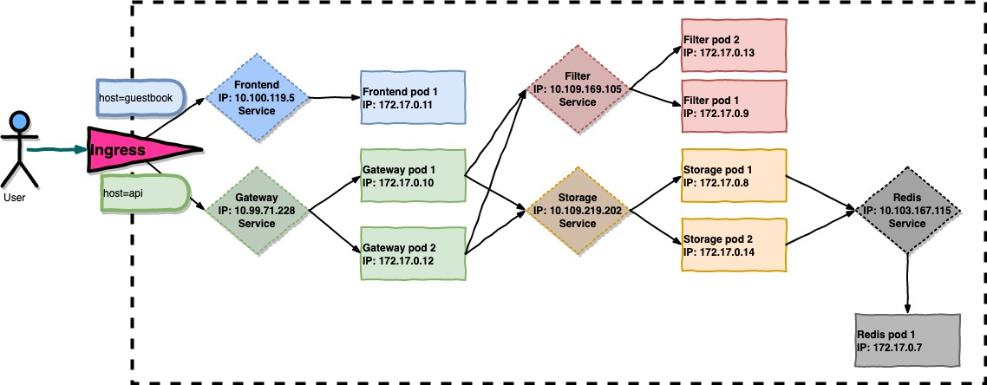
INGRESS FTW !
kubectl get ingresses
ing/frontend ing/gateway
guestbook.mycompany.com
80
80
api.mycompany.com

Slide 249
INGRESSCLASS
It is possible to install multiple IngressController. Then an IngressClass can be specified for each Ingress (spec.ingressClassName) to specify which IngressController to use.
An IngressClass can be declared by default so that you don't have to specify it each time.
apiVersion: networking.k8s.io/v1 kind: Ingress
metadata:
name: app namespace: shopping
spec:
ingressClassName: public rules:
...

Slide 250
ANNOTATIONS
To add specific ingress configuration to an IngressController, it is necessary to use specific annotations.
Refer to the documentation of the IngressController: nginx, haproxy...
apiVersion: networking.k8s.io/v1 kind: Ingress
metadata:
name: app namespace: shopping annotations:
haproxy-ingress.github.io/balance-algorithm: random
haproxy-ingress.github.io/maxconn-server: "500" haproxy-ingress.github.io/ssl-redirect: "false"
# ou
nginx.ingress.kubernetes.io/affinity: cookie spec:
rules:
...

Slide 251


Slide 252
GATEWAY API (1/2)
Due to the universality of Ingress, the configuration is limited
hence the use (abuse?) of annotations, or even specific resources (CRD) for some
IngressController.
it is also limited to the HTTP protocol for now.
To overcome these problems and allow a better separation of roles involved in Kubernetes management, a new solution has been developed: Kubernetes Gateway API
The Gateway API is the successor to the Ingress API; Ingress is frozen, and so new features are being added to the Gateway API.
Graduates to Beta since v1.26, Stable since November 2023

Slide 253
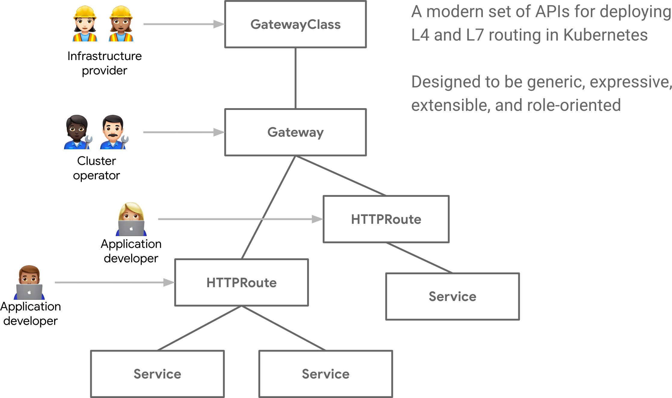
GATEWAY API (2/2)

Slide 254


Slide 255
HEADLESS SERVICES
A Service provides a single entrypoint to a set of Pods
But sometimes the customer needs to know the IPs of the Pods rather than using the IP of the Service (ex: Netflix Ribbon)
It is possible to create a headless Service
To do this, specify clusterIP: None, no ClusterIP will be created
In this case, the DNS resolution of the Service will return all the IPs of the Pods instead of returning a ClusterIP

Slide 256
ACCESSING A POD WITHOUT A SERVICE
It is also possible to temporarily access a Pod without going through a Service, especially for debugging.
The kubectl port-forward command allows you to temporarily forward a local port (of the host from which the kubectl command is launched) to the port of a Pod.
kubectl port-forward whoami 8080:80 Forwarding from 127.0.0.1:8080 -> 80 Handling connection for 8080
Handling connection for 8080

Slide 258
SECURE SERVICES INSIDE A CLUSTER
By default Pods accept traffic from any source
It may be useful to restrict access to/from some Pods To do so you'll use a NetworkPolicy
Pods become isolated when they are matched by a NetworkPolicy You must have a network plugin which supports NetworkPolicy
Otherwise you'll be able to create the object, but it will have no effect

Slide 259
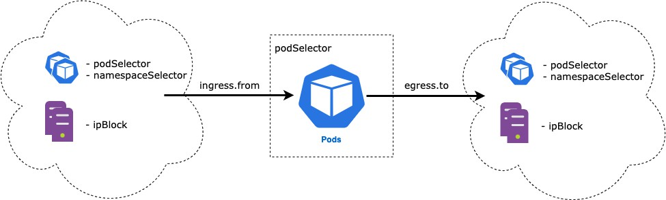
NETWORK POLICY TYPES
Two types of policy can be created:
egress: traffic originating from the selected Pods
ingress: traffic sent to the selected Pods

Slide 260
NETWORKPOLICY EXAMPLE
---
apiVersion: networking.k8s.io/v1 kind: NetworkPolicy
metadata:
namespace: my-project name: api-allow
spec:
podSelector: matchLabels:
role: api
ingress:
- from:
- podSelector: matchLabels:
role: frontend
This policy only allows access to Pods with the label role=api from Pods with label
role=frontend

Slide 261
NAMESPACES ISOLATION
---
apiVersion: networking.k8s.io/v1 kind: NetworkPolicy
metadata:
namespace: my-project
name: deny-from-other-namespaces spec:
podSelector: {}
ingress:
- from:
- podSelector: {}
This policy is deployed in the Namespace my-project podSelector.matchLabels is empty, so it applies to all Pods in the Namespace.
ingress.from.podSelector is empty, so it allows traffic from all Pods in the Namespace. Simulator : https://editor.cilium.io/

Slide 262
QUIZZ
1 | Does a Service assign a fixed IP to Pod ❓
2 | Do NodePort Services allocate a static port on every Node in the cluster to expose the Service ❓
3 | Can Pods communicate with each other within differents Namespaces ❓
4 | Do Ingress provide health checks and automatic failover to ensure high availability of applications ❓
5 | Do LivenessProbes indicate when a container is ready to start receiving traffic ❓
6 | Can StartupProbes be used to prevent traffic from being sent to containers that are still initializing ❓
7 | Can LoadBalancer controllers be used to manage traffic based on hostname or path- based routing rules ❓

Slide 264
VOLUMES
8
© Copyright 2024 bitbox. All rights reserved
2024-12-15#547bc88

Slide 265
AGENDA
Introducing volumes
Simple data share between two containers in a Pod Accessing a Node's FS
PersistentVolumes and PersistentVolumeClaims

Slide 266
INTRODUCING VOLUMES
Files created in a container are ephemeral
If a Pod is restarted, new Pod's containers won't have access to the previous one's files Sometimes multiple containers in a Pod need to share files
Kubernetes Volumes provide a solution for these needs

Slide 267
VOLUME TYPES
emptyDir : initially empty volume
hostPath : path mounted from the cluster node on which the container runs
nfs & iscsi : Network File System (NFS) and Internet Small Computer System Interface (iSCSI) shares mounted as a volume
csi (Container Storage Interface): generic volume declaration based on a driver implementing the spec. Replacement of other deprecated volumes types. Available drivers list
ConfigMaps, Secrets, downwardAPI : special volume types used to expose some Kubernetes resources
PersistentVolumeClaim : a way of dynamically provision volumes

Slide 268
VOLUME TYPES - DEPRECATED
the following volumes are deprecated and replaced with the csi: volumes offered by cloud infrastructure providers:
gcePersistentDisk : Google Compute Engine Persistent Disk
awsElasticBlockStore : Amazon Web Services Elastic Block Store Volume azureDisk : Microsoft Azure Disk Volume
network based shared storage: cephfs, cinder, vsphereVolume, rbd, ...
-- https://kubernetes-csi.github.io/docs/drivers.html

Slide 269
EMPTYDIR VOLUME TYPE
An emptyDir allows us to mount ... an empty directory! That way, the workload running inside the Pod can write in it
Warning: the emptyDir volume lifecycle is linked to the Pod's lifecycle If the Pod is destroyed, the emptyDir is also destroyed
This volume type is used to share data between multiple containers in the same Pod

Slide 270
SHARING DATA BETWEEN TWO CONTAINERS IN THE SAME POD
---
apiVersion: v1 kind: Pod metadata:
name: shared-vol
spec:
volumes:
name: my-shared-data emptyDir: {}
containers:
name: log2fs
image: bitbox/k8s-training-nginx-log2fs:1.19-alpine-v1 volumeMounts:
name: my-shared-data
mountPath: /var/log/nginx
name: shell
image: debian:11-slim
command: ["bash", "-c", "sleep infinity"] volumeMounts:
name: my-shared-data
mountPath: /data

Slide 271
ACCESSING A NODE'S FS
Pods should run on anywhere on the cluster, regardless of the node
But sometimes certain system Pods need to have access to a node's resources (files, process, network...)
for instance: using Pods from a DaemonSet to centralize logs
hostPath volumes have that purpose: accessing a node's FS

Slide 272
PRECAUTIONS WHEN USING 'HOSTPATH' VOLUMES
hostPath volumes are persistent and are stored on the Node Accessing persisted data is inconsistent
Since new Pods can run anywhere on the cluster

Slide 273
"HOSTPATH" EXAMPLE USAGE
---
apiVersion: v1 kind: Pod metadata:
name: hostpath-vol
spec:
volumes:
name: my-host-data hostPath:
path: /data/my-data
containers:
name: log2fs
image: bitbox/k8s-training-nginx-log2fs:1.19-alpine-v1 volumeMounts:
- name: my-host-data
mountPath: /var/log/nginx

Slide 275
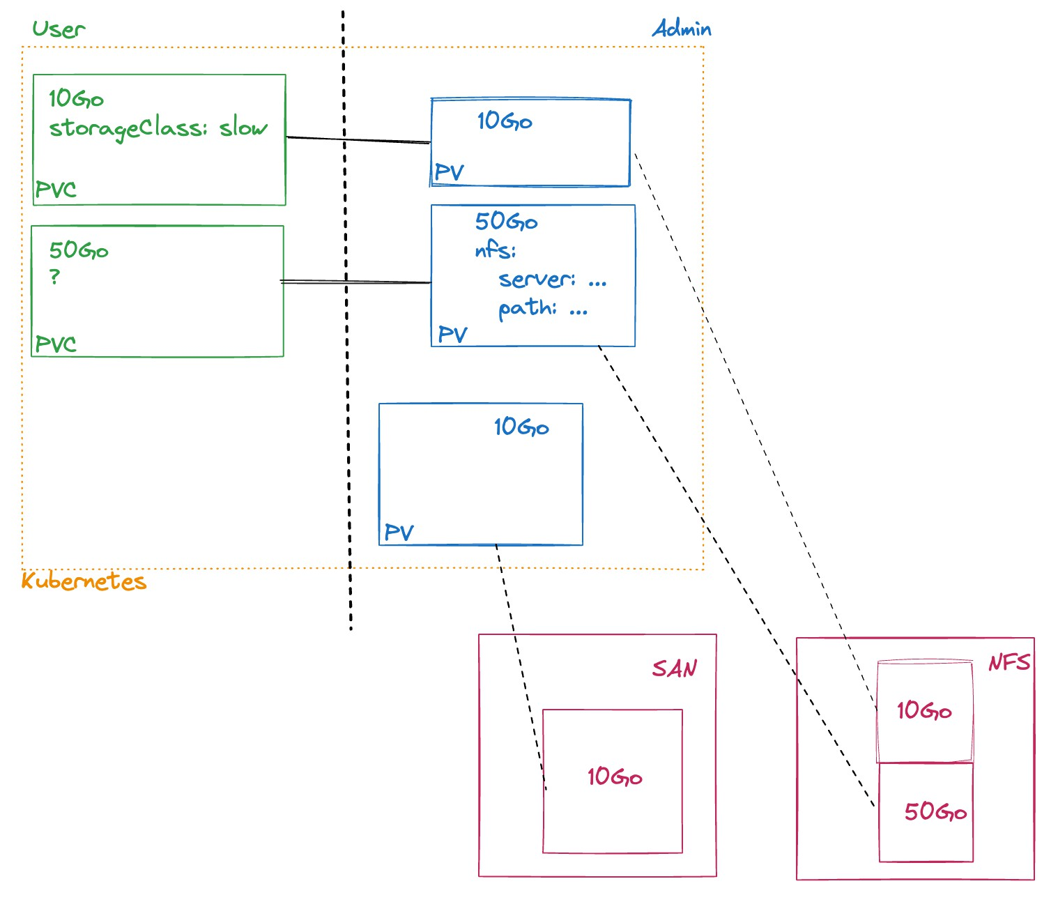
PERSISTENTVOLUMES AND PERSISTENTVOLUMECLAIMS
The concept of PersistentVolumes allows cluster administrators to provide a layer of abstraction for consumption and provisioning of Volumes
This abstraction layer relies on PersistentVolumes and PersistentVolumeClaims
PersistentVolume (PV): a storage space that has been reserved by the cluster administrators
PersistentVolumeClaim (PVC): a request for storage space from cluster users

Slide 276
PERSISTENTVOLUMECLAIM VS. PODS
PVC are similar to Pods:
The Pods consume resources (CPU & Memory) of the nodes of the cluster PVC consume cluster storage resources
The PVC provide PersistentVolumes matching some criteria: size and type of access (ReadOnly/ReadWrite/...)
... while not having to expose to cluster users how volumes are provisioned
The StorageClass are the way for the administrators to expose the different types of volumes available

Slide 277
VOLUMES AND PERSISTENTVOLUMECLAIMS LIFE CYCLE
PersistentVolumes can be provisioned Statically or Dynamically Static PV are PV pre-provisioned by administrators
Dynamic PV are PV provisioned on the fly by the cluster based on a StorageClass A PersistentVolumeClaim must specify the type of StorageClass desired
An empty StorageClass ("") is equivalent to requesting a static PV

Slide 278
"BINDING"
A user creates a PersistentVolumeClaim specifying the size of the storage space and the desired access mode
The cluster examines the PersistentVolumes available and corresponding at least to the request
The user will always have at least what he asked for, but can have more, and the association between the PVC and the PV is made
If no PV matches the request, it remains pending indefinitely (or until deletion)

Slide 279
"USING"
The Pod uses PVC as volumes
The cluster inspects the PVC to find the associated PV and mounts the volume in the Pod
Once the user has created a PVC and this PVC is associated with a PV, the associated PV belongs to the user as long as he needs it

Slide 280
"RECLAIMING"
When the user no longer needs the volume, he can delete the associated PVC
Warning, deleting a Pod does not delete the associated PersistenceVolumeClaims!
The ReclaimPolicy associated with the PersistentVolume determines what happens to the PersistentVolume once it has been released:
Retained: the PV is no longer in use but cannot be associated with another PersistentVolumeClaim until an administrator releases it
Recycled: the PersistentVolume is cleaned, i.e. the data stored there is deleted. Then it can be associated again with a PVC
Deleted: the PersistentVolume is deleted (e.g. AzureDisk, GC Disk, AWS EBS...)

Slide 281
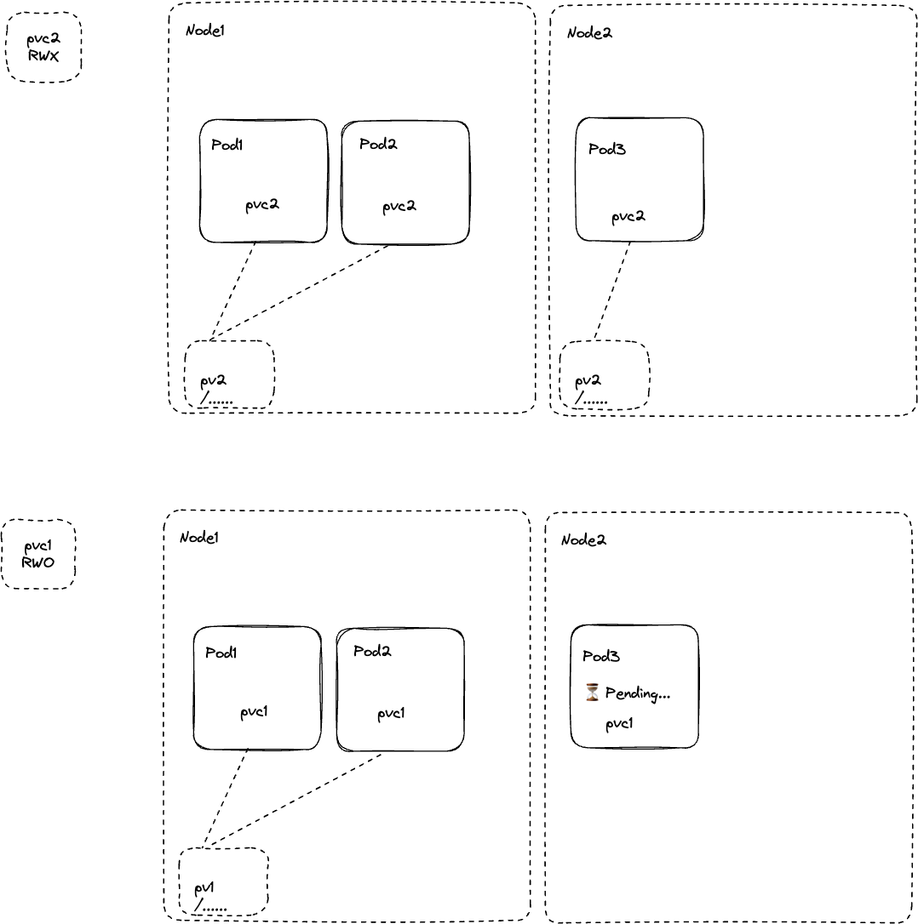
ACCESS MODES
ReadWriteOnce (RWO): the volume can be mounted as read-write by only one node
ReadWriteOncePod (RWOP): the volume can be mounted as read-write by a single Pod
ReadOnlyMany (ROX): the volume can be mounted as read-only by several nodes
ReadWriteMany (RWX): the volume can be mounted as read-write by several nodes
⚠ A volume can only be mounted in one mode at a time, even if it supports multiple modes

Slide 282
EXAMPLE OF PERSISTENTVOLUME
---
apiVersion: v1
kind: PersistentVolume metadata:
name: pv0003
spec:
capacity: storage: 5Gi
accessModes:
ReadWriteOnce
ReadWriteMany persistentVolumeReclaimPolicy: Retain storageClassName: slow
nfs:
path: /data/vol1 server: 172.17.0.2
mountOptions:
hard
nfsvers=4.1

Slide 283
EXAMPLE OF PERSISTENTVOLUMECLAIM
---
apiVersion: v1
kind: PersistentVolumeClaim metadata:
name: myclaim
spec:
accessModes:
- ReadWriteOnce resources:
requests:
storage: 8Gi storageClassName: slow selector:
matchLabels: release: "stable"
matchExpressions:
- {key: environment, operator: In, values: [dev]}

Slide 284
USING THE PVC
---
apiVersion: v1 kind: Pod metadata:
name: mypod
spec:
volumes:
name: mypd persistentVolumeClaim:
claimName: myclaim
containers:
name: myfrontend image: nginx:stable volumeMounts:
- name: mypd
mountPath: /var/www/html

Slide 285
EXAMPLE OF STORAGECLASS
---
apiVersion: storage.k8s.io/v1 kind: StorageClass
metadata:
name: my-custom-class provisioner: ebs.csi.aws.com allowVolumeExpansion:
volumeBindingMode: WaitForFirstConsumer
parameters: csi.storage.k8s.io/fsType: xfs type: gp3

Slide 288
CONFIGURATION AND SECRETS
9
© Copyright 2024 bitbox. All rights reserved
2024-12-15#547bc88

Slide 289
AGENDA
Environment variables ConfigMaps
Secrets

Slide 290
ENVIRONMENT VARIABLES
The purpose of containers is to be able to use the same image across all environments But each environment comes with its own characteristics
It is common to adapt the behavior of a container using environment variables For example :
a JDBC url
the name of an external service used for authentication a Spring profile

Slide 291
ENVIRONMENT VARIABLE DECLARATION
---
apiVersion: apps/v1 kind: ReplicaSet metadata:
name: docker-registry
spec:
replicas: 1 template:
metadata:
labels:
app: registry spec:
containers:
name: registry image: registry:2 env:
name: REGISTRY_ADDR
value: "prod.registry.mycompany.com:9090"
name: REGISTRY_HEALTH_HTTP_TRESHOLD
value: "5"

Slide 292
CONFIGMAPS
👎 The disadvantage of using environment variables is that you will have to build descriptors for each environment
The main goal of configuration is to be able to separate values changing for each environment from the source code of the application
... and your descriptors should be part of the application source code (Everything as a code)
Kubernetes allows to completely separate the configuration of an application by using the ConfipMap resource type

Slide 293
LITERAL VALUES
ConfigMap can be created from a descriptor
---
apiVersion: v1 kind: ConfigMap metadata:
name: special-config
data:
SPECIAL_HOW: very SPECIAL_TYPE: charm
ConfigMap can be created from literal values
kubectl create configmap special-config \
--from-literal=SPECIAL_HOW=very \
--from-literal=SPECIAL_TYPE=charm

Slide 294
CONFIGMAPS USAGE: ENVIRONMENT VARIABLES
---
apiVersion: v1 kind: Pod metadata:
name: dapi-test-pod
spec:
containers:
- name: test-container image: debian:11-slim
command: [ "bash", "-c", "env | grep SPECIAL" ]
env:
- name: SPECIAL_LEVEL_KEY
valueFrom: configMapKeyRef:
name: special-config
key: SPECIAL_HOW
Execution result: SPECIAL_LEVEL_KEY=very

Slide 295
IMPORT ALL KEYS FROM A CONFIGMAP
---
apiVersion: v1 kind: Pod metadata:
name: dapi-test-pod
spec:
containers:
- name: test-container image: debian:11-slim
command: [ "bash", "-c", "env | grep SPECIAL" ]
envFrom:
- configMapRef:
name: special-config
Execution result: SPECIAL_HOW=very and SPECIAL_TYPE=charm

Slide 296
CONFIGMAP FROM A DIRECTORY
It's also possible to import a file or a whole directory, a key will be created for each file
configs/
|- game.properties
`- ui.properties
// game.properties enemies=aliens lives=3 enemies.cheat=true
secret.code.allowed=true
secret.code.lives=30
// ui.properties color.good=purple color.bad=yellow allow.textmode=true how.nice.to.look=fairlyNice
kubectl create configmap game-config --from-file configs/

Slide 297
DIRECTORY IMPORT RESULT
kubectl get configmaps game-config -o yaml
---
apiVersion: v1 kind: ConfigMap metadata:
name: game-config
data:
game.properties: |- enemies=aliens lives=3 enemies.cheat=true
secret.code.allowed=true secret.code.lives=30
ui.properties: |-
color.good=purple color.bad=yellow allow.textmode=true how.nice.to.look=fairlyNice

Slide 298
CREATE A VOLUME FROM A CONFIGMAP
---
apiVersion: v1 kind: Pod metadata:
name: dapi-test-pod
spec:
volumes:
name: config-volume configMap:
name: game-config
containers:
name: test-container image: debian:11-slim
command: [ "bash", "-c", "ls /etc/config/" ]
volumeMounts:
- name: config-volume mountPath: /etc/config
A file will be created for each keys in the ConfigMap
The file content will be the value associated with each key Execution result: game.properties ui.properties

Slide 299
CONFIGMAPS USAGE CONSTRAINTS
You must create a ConfigMap BEFORE referencing it in a Pod
If you reference a ConfigMap that does not exist in a Pod definition, the Pod will be in error: CreateContainerConfigError
The same thing happen if you reference a key that does not exist
A ConfigMap is only valid/usable in the Namespace where it was created

Slide 300


Slide 301
SECRETS
Secret resources are made to store sensitive information such as passwords, OAuth tokens, certificates or SSH keys
Storing this information in a Secret is more secure and flexible than storing it in cleartext in a Pod descriptor
Making the distinction from ConfigMap allows finer grained right management RBAC is also used to restrict who can access them
In fact, the Secrets are a kind of customized ConfigMap

Slide 302

TYPES OF SECRETS
Opaque | arbitrary user-defined data
kubernetes.io/service-account-token | ServiceAccount token
kubernetes.io/dockercfg | serialized ~/.dockercfg file
kubernetes.io/dockerconfigjson | serialized ~/.docker/config.json file
kubernetes.io/basic-auth | credentials for basic authentication
kubernetes.io/ssh-auth | credentials for SSH authentication
kubernetes.io/tls | data for a TLS client or server
bootstrap.kubernetes.io/token | bootstrap token data

Slide 303
SECRETS STORAGE (1/2)
Either you encode the values to store as Base64
echo -n "admin" | base64 YWRtaW4=
echo -n "1f2d1e2e67df" | base64
MWYyZDFlMmU2N2Rm
---
apiVersion: v1 kind: Secret metadata:
name: mysecret type: Opaque data:
username: YWRtaW4=
password: MWYyZDFlMmU2N2Rm

Slide 304
SECRETS STORAGE (2/2)
Or you leave that to Kubernetes
kubectl create secret generic mysecret \
--from-literal='username=admin' \
--from-literal='password=1f2d1e2e67df' secret/mysecret created
---
apiVersion: v1 kind: Secret metadata:
name: mysecret type: Opaque stringData:
username: admin
password: 1f2d1e2e67df

Slide 305
VIEW A SECRET
kubectl get secret mysecret -o yaml
---
apiVersion: v1 kind: Secret metadata:
name: mysecret
type: Opaque data:
username: YWRtaW4=
password: MWYyZDFlMmU2N2Rm

Slide 306
USE A SECRET TO CREATE FILES
---
apiVersion: v1 kind: Pod metadata:
name: mypod
spec:
volumes:
name: foo secret:
secretName: mysecret
containers:
name: mypod
image: redis:alpine volumeMounts:
- name: foo
mountPath: "/etc/foo" readOnly:
Each keys will be used to create a file

Slide 307
USE A SECRET TO DEFINE AN ENVIRONMENT VARIABLE
---
apiVersion: v1 kind: Pod metadata:
name: secret-env-pod
spec:
containers:
name: mycontainer image: redis:alpine env:
name: SECRET_USERNAME
valueFrom: secretKeyRef:
name: mysecret
key: username
name: SECRET_PASSWORD
valueFrom: secretKeyRef:
name: mysecret
key: password

Slide 308
USE A SECRET TO FETCH AN IMAGE FROM A PRIVATE REGISTRY
apiVersion: v1 kind: Secret metadata:
name: my-docker-creds-secret
type: kubernetes.io/dockerconfigjson data:
.dockerconfigjson: eyJodHRwczovL2luZG54L ... J0QUl6RTIifX0=
apiVersion: v1 kind: Pod metadata:
name: pod-with-private-image spec:
containers:
name: mycontainer
image: registry.internal.company.com/my-secret-image imagePullSecrets:
name: my-docker-creds-secret

Slide 309
USE A SECRET TO EXPOSE AN HTTPS INGRESS
apiVersion: v1 kind: Secret metadata:
name: testsecret-tls
type: kubernetes.io/tls data:
tls.crt: base64 encoded cert
tls.key: base64 encoded key
apiVersion: networking.k8s.io/v1 kind: Ingress
metadata:
name: tls-example-ingress spec:
tls:
hosts:
- https-example.foo.com secretName: testsecret-tls
rules:
host: https-example.foo.com
...

Slide 310
ENCRYPTION ... OR NOT
⚠ by default,
are not encrypted in the
database
why ? Excerpt from this
By creating a threat model that includes the kinds of attacks you want to mitigate, it's clear that managing secrets safely is extremely difficult. The problem is NOT that secrets are just base64 encoded; that was never meant as a security feature. And the problem cannot be simply waved away by software/cloud providers and their flashy documentation.
Mitigation:
setup a EncryptionConfig for an encryption-provider
Integration of Vault (Hashicorp) to manage Secrets https://github.com/Boostport/kubernetes-vault
Store encrypted values directly in Secrets with sealed-secrets

Slide 311


Slide 313
SERVICE ACCOUNT & AUTHORIZATIONS
5
© Copyright 2024 bitbox. All rights reserved
2024-12-15#547bc88

Slide 314
AGENDA
RBAC descriptors Service Account

Slide 315
AUTHENTICATION USER
Human can be authenticated with:
OpenID Connect, a flavor of OAuth2 supported by some providers (Azure Active Directory, Salesforce and Google)
Authentication webhook Authentication proxy
...

Slide 316
AUTHORIZATION: RBAC AND ROLE BINDING
Three kind of resources involved:
User, ServiceAccount: who? Role/ClusterRole: what is allowed?
RoleBinding/ClusterRoleBinding: Role/ClusterRole affected to a User or ServiceAccount

Slide 317
RBAC - ROLE
A Role is a set of permission on some resources Permissions are additive (only Allow rules)
Defines permissions on resources within a Namespace
apiVersion: rbac.authorization.k8s.io/v1 kind: Role
metadata:
namespace: shopping name: pod-reader
rules:
- apiGroups: [""] # "" indicates the core API group resources: ["pods"]
verbs: ["get", "watch", "list"]
List of verbs: get, list, watch, create, update, patch, delete...

Slide 318
RBAC - ROLEBINDING
Example of RoleBinding allowing "jane" to read Pods in the "shopping" Namespace
apiVersion: rbac.authorization.k8s.io/v1 kind: RoleBinding
metadata:
name: read-pods namespace: shopping
subjects:
- kind: User
name: jane # Name is case sensitive apiGroup: rbac.authorization.k8s.io
roleRef:
kind: Role #this must be Role or ClusterRole
name: pod-reader # this must match the name of the Role or ClusterRole you wish to bind to apiGroup: rbac.authorization.k8s.io

Slide 319
RBAC - CLUSTERROLE/CLUSTERROLEBINDING
A ClusterRole is used to grant permissions on resources:
Cluster scoped resources (See kubectl api-resources) Namespaced resources across all Namespaces
Non-resource endpoints (like /healthz)
apiVersion: rbac.authorization.k8s.io/v1 kind: ClusterRole
metadata:
# "namespace" omitted since ClusterRoles are not namespaced name: secret-reader
rules:
- apiGroups: [""] resources: ["secrets"]
verbs: ["get", "watch", "list"]

Slide 320
CURRENT IDENTITY
To find the current identity:
kubectl auth whoami
ATTRIBUTE
Username Groups
VALUE
minikube-user
[system:masters system:authenticated]

Slide 321
RBAC - AUDIT RIGHTS (1/2)
To check the current user rights, you may use the command:
it is the permissions associated to the previous Role with pod-reader
kubectl auth can-i --list Resources | Non-Resource | URLs | Resource | Names | Verbs
selfsubjectaccessreviews.auth.k8s.io | [] |  | [] |  | [create]
selfsubjectrulesreviews.auth.k8s.io | [] |  | [] |  | [create]
pods | [] |  | [] |  | [get watch list]
 | [/api/*] |  | [] |  | [get]
 | [/api] |  | [] |  | [get]
 | [/apis/*] |  | [] |  | [get]
[...]

Slide 322
RBAC - AUDIT RIGHTS (2/2)
Exemple of rights with admin privileges:
kubectl auth can-i --list Resources | Non-Resource | URLs | Resource | Names | Verbs
*.* | [] |  | [] |  | [*]
 | [*] |  | [] |  | [*]
selfsubjectaccessreviews.authorization.k8s.io | [] |  | [] |  | [create]
selfsubjectrulesreviews.authorization.k8s.io | [] |  | [] |  | [create]
 | [/api/*] |  | [] |  | [get]
 | [/api] |  | [] |  | [get]
 | [/apis/*] |  | [] |  | [get]
 | [/apis] |  | [] |  | [get]
 | [/version] |  | [] |  | [get]
 | [/version] |  | []
[...]

Slide 323
SERVICE ACCOUNTS (1/3)
User accounts are meant to be used by humans.
But when a Pod running in the cluster wants to access the Kubernetes API server, it needs to use a service account instead.
Service accounts are just like user accounts but for non-humans.
Service accounts are automatically created and associated with Pods when the ServiceAccount admission controller is enabled.
kubectl get serviceaccount NAME SECRETS AGE
default 0 3h
kubectl get pods whoami -o jsonpath='{.spec.serviceAccount}' default

Slide 324
USAGE IN A POD
Using a ServiceAccount in a Pod:
apiVersion: v1 kind: Pod metadata:
name: pod-with-sa
spec:
serviceAccountName: build-robot containers:
[...]

Slide 325
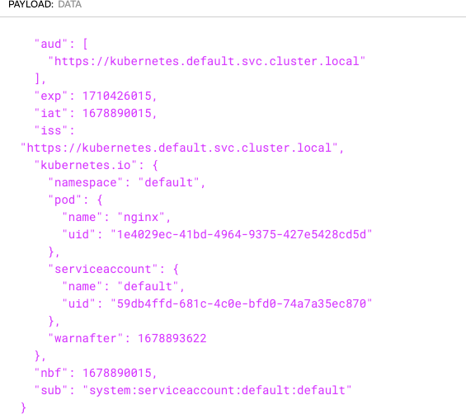
JWT TOKEN
A token (JWT) will be available in the Pod under
/var/run/secrets/kubernetes.io/serviceaccount/token

Slide 328
AUTOSCALING
12
© Copyright 2024 bitbox. All rights reserved
2024-12-15#547bc88

Slide 329
AGENDA
Auto-scaling

Slide 330
AUTO-SCALING
Pod horizontal auto-scaling is the automatic scaling of a controller's replica count
It is performed by a controller called autoscaler which is driven by a HorizontalPodAutoscaler resource
The controller regularly checks (f=30s by default) the metrics of the Pods concerned and calculates the number of replicas in relation to the auto-scaling criteria configured for the target resource (Deployment, ReplicaSet)
The metrics are either: CPU/memory resources custom metrics

Slide 331
CONFIGURATION
kubectl autoscale deployment autosc --cpu-percent=60 --min=1 --max=5 horizontalpodautoscaler.autoscaling/autosc autoscaled
kubectl get hpa
NAME | REFERENCE | TARGETS | MINPODS | MAXPODS | REPLICAS | AGE
autosc | Deployment/autosc | <unknown>/60% | 1 | 5 | 0 | 28s

Slide 332
AUTOSCALING DESCRIPTOR: V1
In autoscaling/v1 version, only cpu usage is supported:
---
apiVersion: autoscaling/v1 kind: HorizontalPodAutoscaler metadata:
name: autosc
spec:
maxReplicas: 5
minReplicas: 1 scaleTargetRef:
apiVersion: apps/v1
kind: Deployment name: autosc
targetCPUUtilizationPercentage: 60

Slide 333
AUTOSCALING DESCRIPTOR: V2 1/2
In autoscaling/v2 version (k8s >= 1.23), cpu+memory are supported as well as custom metrics:
apiVersion: autoscaling/v2 kind: HorizontalPodAutoscaler metadata:
name: php-apache
namespace: default spec:
scaleTargetRef: { apiVersion: apps/v1, kind: Deployment, name: php-apache }
minReplicas: 1
maxReplicas: 10 metrics:
- type: Resource
resource: name: cpu target:
type: Utilization
averageUtilization: 50
[...]

Slide 334
AUTOSCALING DESCRIPTOR: V2 2/2
metrics: [...]
type: Pods
pods:
metric:
name: packets-per-second target:
type: AverageValue
averageValue: 1k
type: ContainerResource containerResource:
name: cpu
container: application target:
type: Utilization
averageUtilization: 60
type: Object object:
metric:
name: requests-per-second
describedObject: { apiVersion: networking.k8s.io/v1, kind: Ingress, name: main-route } target:
type: Value
12 - 6
value: 100
© Copyright 2024 bitbox. All rights reserved

Slide 337
SUMMARY
15
© Copyright 2024 bitbox. All rights reserved
2024-12-15#547bc88

Slide 338
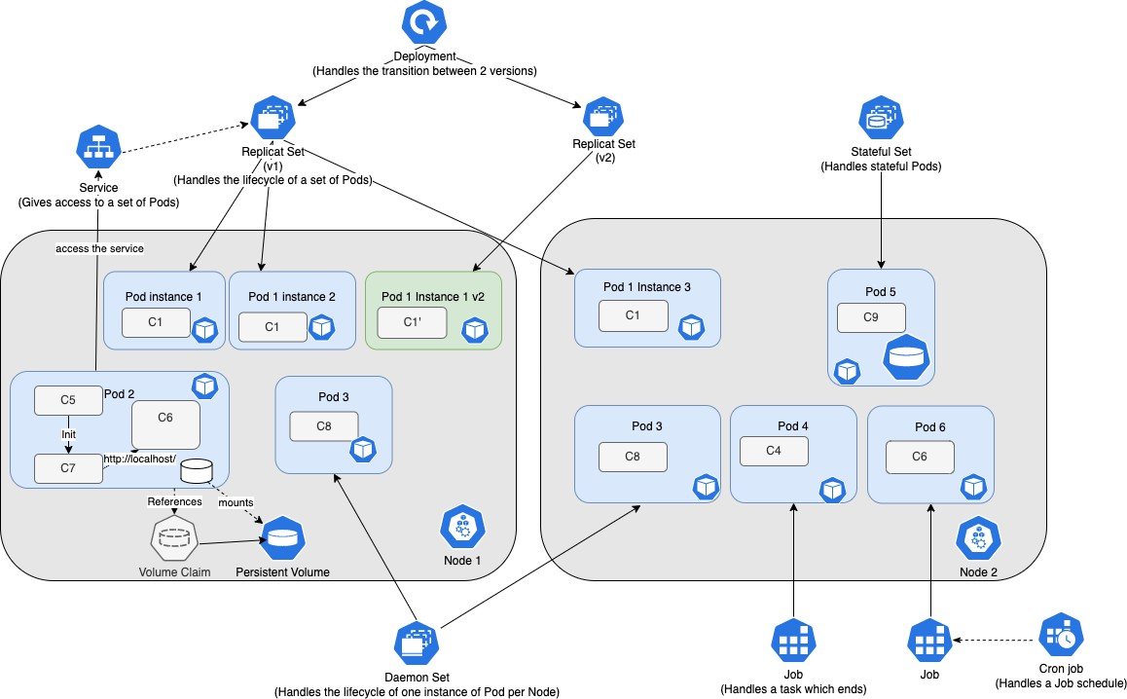
RESOURCES SUMMARY

Slide 339
KUBERNETES READY APPLICATIONS
https://medium.com/@bibryam/cloud-native-container-design-principles-144ceaa98dba

Slide 340
KUBERNETES THE HARD WAY
https://github.com/kelseyhightower/kubernetes-the-hard-way by Kelsey Hightower
Manual Kubernetes installation tutorial Optimised toward learning:
Detailed and complete installation to understand each steps needed to create a Kubernetes cluster

Slide 341
KUBERNETES SHOULD NOT COME ALONE
Kubernetes is not usable without further integrations
Cluster creation/upgrade automation Centralized logging and monitoring Persistent storage solution
Load balancer/Reverse proxy Container image registry

Slide 342
BEST PRACTICES FOR YOUR DESCRIPTORS
Use Deployments
Configure Startup, Readiness and Liveness probes Use Init Containers
Think twice before making multi-container Pods
Specify the ImagePullPolicy
Specify resources allocations and limits: Requests and Limits
Use labels and annotations
Use Kubernetes ASAP!
Your descriptors are also code, put them in git! (declarative mode)

Slide 343
KUBERNETES AND SECURITY
Kubernetes popularity increases the need to secure it. Some resources that can help:
CIS Benchmark: Security Guide
OWASP Kubernetes TOP10: List of the 10 most common flaws

Slide 344
CKAD
Only official documentation is allowed Be comfortable with vim
Use kubectl create|run --dry-run=client -o yaml to save time Before starting, don't forget to open the official Cheat Sheet
Add the following lines in its ~/.vimrc file to facilitate YAML editing
set expandtab set sw=2
set ts=2
There are also many blog articles giving additional information to be well prepared on the day of the exam.

Slide 345
KUBERNETES, AND THEN?
Kubernetes alone is not enough...
A ServiceMesh to manage traffic shaping (Linkerd, Istio, ...) CertManager to manage your HTTPS certificates
Vault to encrypt your secrets
ArgoCD, Flux to manage your GitOps workflow
...

Slide 346
NEXT STEP...
Kubernetes administration training
Understand the architecture and internal workings of a Kubernetes platform Install and operate a Kubernetes cluster
Distinguish and choose the different tools related to the maintenance of a cluster (network, logs, metrics)
Configure and operationally monitor a Kubernetes cluster

Slide 347


